Slide 1
Free Tools for teaching & learning
Shuyan Wang, Ph.D., USM
Gregory Zobel, Ph.D., WOU

Slide 2
Purpose & Goals

Slide 3

Provide
Practical Solutions
Use these tools today
Easy to register & sign up
Most have Chinese language interfaces
Create content to support teaching & learning

Slide 4

You can start using today
Easy to get started
Fast content creation
Interfaces are friendly
Multiple export files
All you need is Internet

Slide 5

Available Online & for Free
Most just require registration
  If you like, just create an extra throw-away account at Yahoo for all your online tools

Slide 6
Content Creation
Making meaningful learning materials

Slide 7
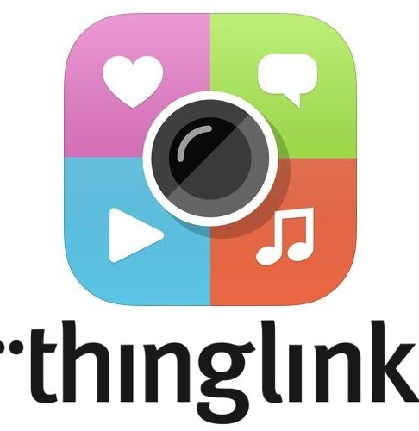
ThingLink
ThingLinks are images with hyperlinks to different media, texts, websites, or photos.
Better seen than explained.
Simple text-only ThingLink
Another student example
GZ’s Sample ThingLink

Slide 8

Online Chart Tool: free data charting, graphing tools
* Create engaging data visualizations.
* Help colleagues understand your achievements or program.
* Help students understand how to work with data.
https://www.onlinecharttool.com

Slide 9
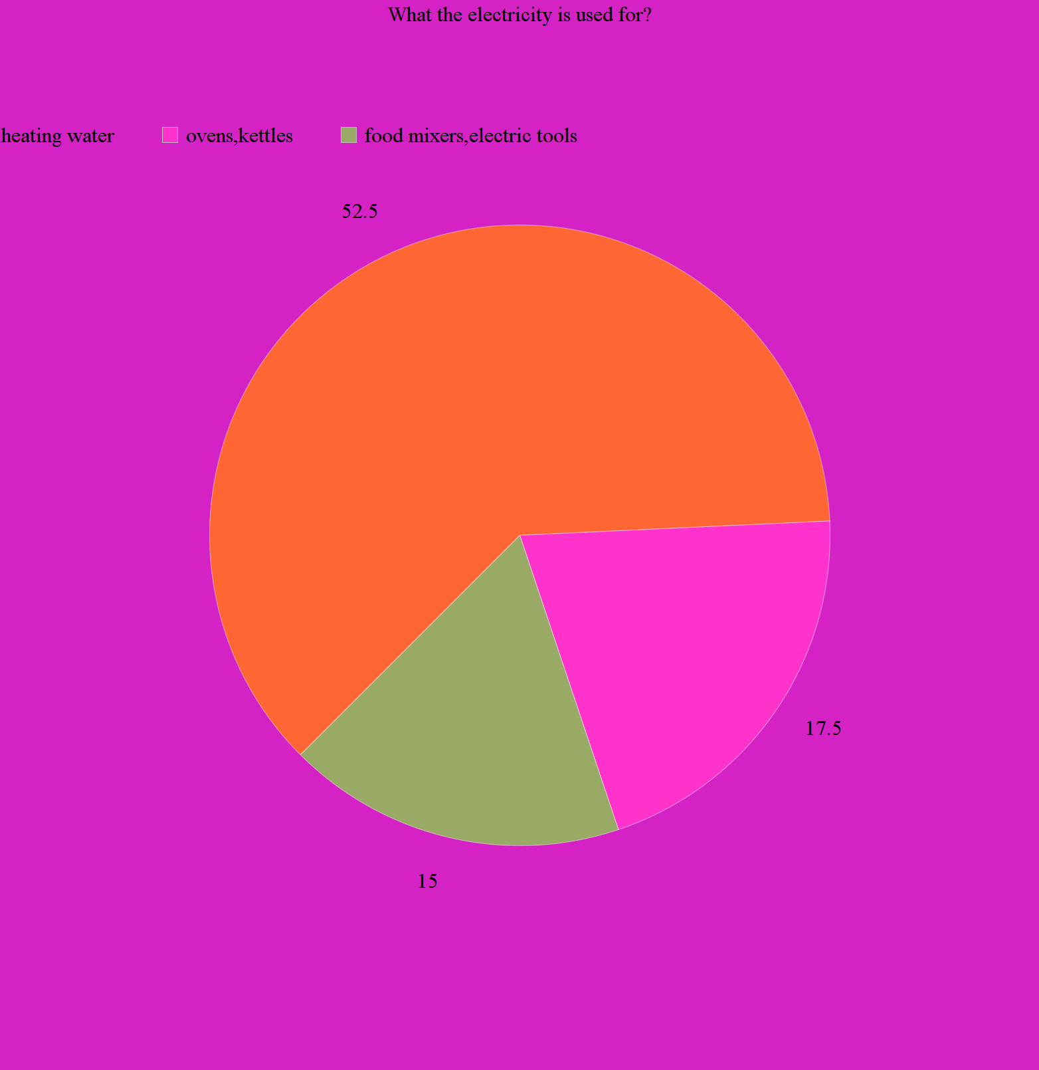
Student example 1

Slide 10
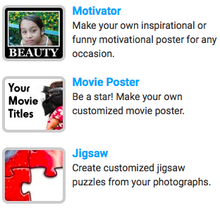
Big Huge Labs: image editing & meme creation tools
Multiple fun, simple tools
Students can create images for projects
Create images for courses
Practice combining text and images.
Student examples next

Slide 11

Notes:
Morgan: image demonstrating key point in her pedagogy

Slide 12

Notes:
Elaine: image that shows part of their pedagogy

Slide 13
Content Sharing

Slide 14

Zoho: Create presentations online
Presentations
Word Processing
Collaboration
Multiple export files

Slide 15
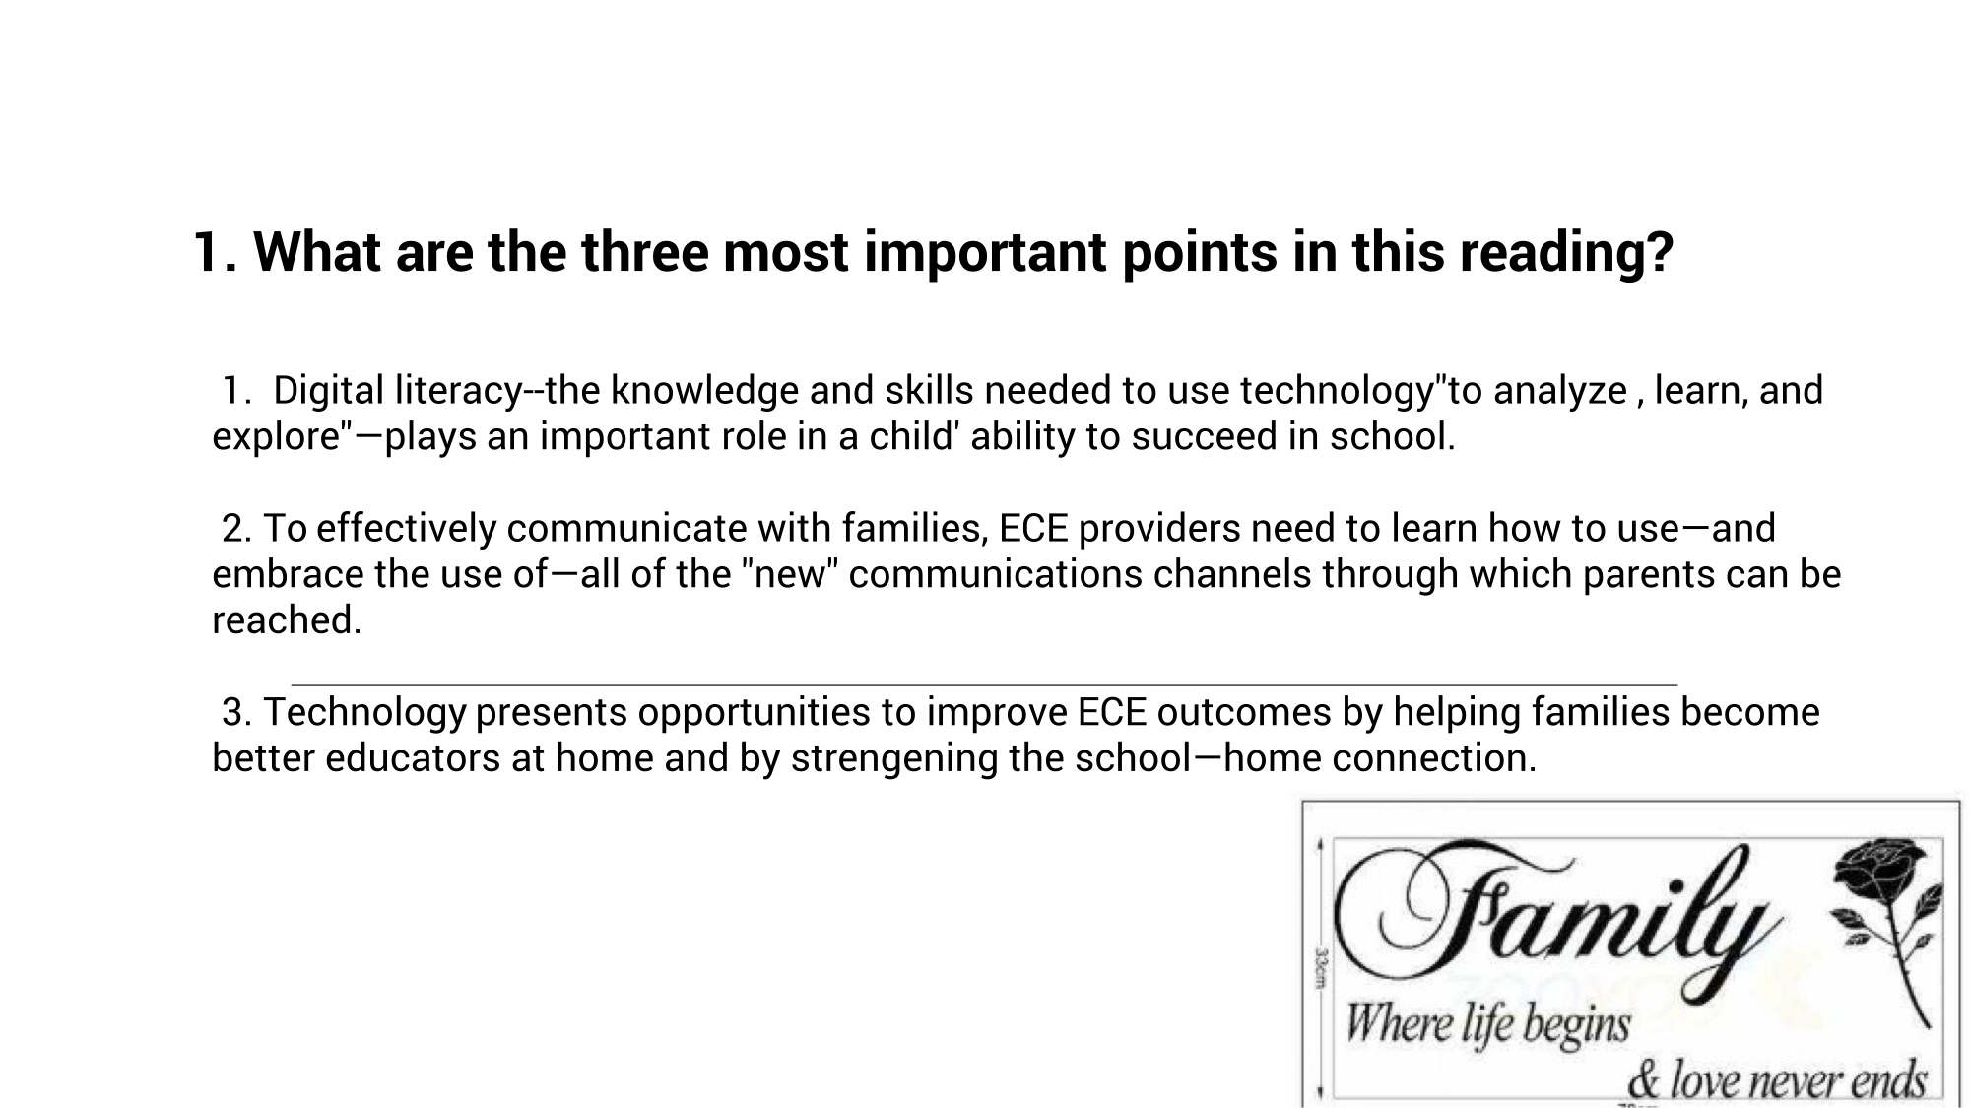
Notes:
Student slide, Golden Section

Slide 16
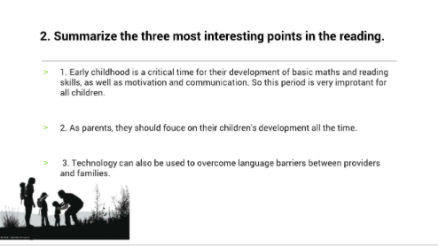

Slide 17

Padlet
An electronic whiteboard
Sample Padlet
Easy collaboration & publication tools
Publish & share content
  Sites
  Photos
  Audio
  Video
Project submission (example)

Slide 18
Video and Audio creating & EDITING

Slide 19


PowToon
Create animated videos & presentations
Free and easy to use
Five minutes and 100 MB
Tutorials were provided
https://www.powtoon.com/html5_tutorials/
Student’s video example in Powton

Slide 20
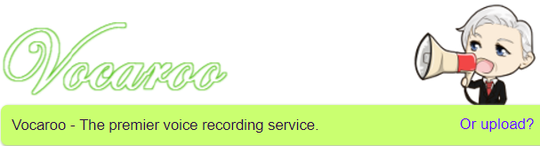
Vocaroo
Vovaroo is an audio editing software
Free and easy to use
Download as various formats

Slide 21
Assessment

Slide 22

ClassDojo
Classroom management tool
Easy & Free
Works on multiple devices (iOS, Andriod, and Chromebook)
Record and upload videos (8 minutes in length
Journal entries for students to write and reflect on their work
Draw and annotates on photos
Voice notes
https://www.classdojo.com

Slide 23

Testmoz
Testmoz is a test generator that sports 4 question types, automatic grading, a really simple interface and detailed reports.
Free and don’t require registration
50 questions and 100 responses
Sample questions: testmoz.com/1368973

Slide 24

Poll everywhere
Poll Everywhere allows live interactive audience participation
Engages your audience or class in real time
Free, easy to use and powerful
Sample survey

Slide 25

Wenjuanxing
Wenjuanxing is a powerful online test maker
Free and easy to use
In Chinese
Survey, quiz, poll, evaluation, and so on
Sample survey

Slide 26
BLogfolio
Preserving and Demonstrating Student and Professional Learning

Slide 27
Defining Blogfolio
Blogfolio combines two components:
  Blog
  Portfolio
Thus a Blogfolio is used to both create and post content, writing, and content in regular posts, as we do with blogs, and share collected examples or works that can support professional, personal, or academic work and achievements, like we do with portfolios.

Slide 28
Why use a Blogfolio?
Documenting work
Sharing accomplishments
Support job/employment search
Can be used by teachers and students
Supports long-term reflection on learning and professional development

Slide 29

WordPress
Two versions
  Free, online version
  Free to host on your server
https://wordpress.org/
Students’ blog examples
https://ed326.wordpress.com/
More examples http://blogfolios.weebly.com/

Slide 30
Other Tools

Slide 31
Classroom Tool Creators
Word Search Puzzles: https://mywordsearch.com
Printable Flash Card Creator: http://www.kitzkikz.com/flashcards/

Slide 32
Basic Cartoon & Animation Creation
ToonDoo: http://toondoo.com/
ToonyTool: https://www.toonytool.com/
Parapara: http://parapara.mozlabs.jp/

Slide 33
OER
Open Courses
http://open.163.com/
Autonomous Learning Resources
http://www.zizhuxuexi.cn/
Elementary Animation Classes:
http://www.dm5u.com/

Slide 34
Open Textbooks
College Open Textbooks: http://www.collegeopentextbooks.org
Open Textbook Library: https://open.umn.edu/opentextbooks/
Open Stax: https://openstax.org/subjects
Wikiversity: https://www.wikiversity.org

Slide 35
Additional Blogfolio Resources
Weebly: http://mahara.org
Blogger: https://www.blogger.com
Mahara: http://mahara.org

Slide 36
Questions?

Slide 37
Thank you!
Shuyan.Wang@usm.edu
zobelg@wou.edu

