Slide 1
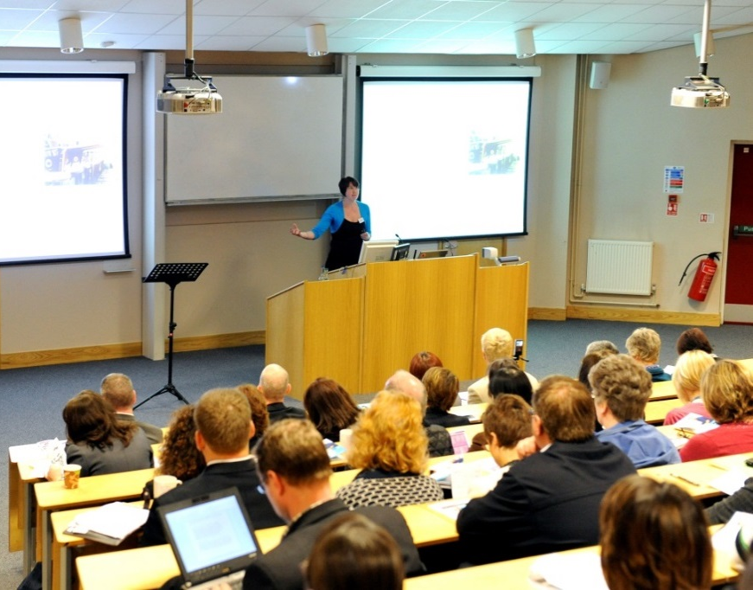

英国的高等教育
与课堂教学
工学院
刘伟

Slide 2
英国的教育体系与高校
课堂教学方法
提高学习的积极性（Activity）
课程考核（Assessment）
小组学习（Group work）

Slide 3
英国的教育体系与高校
课堂教学方法
提高学习的积极性（Activity）
课程考核（Assessment）
小组学习（Group work）

Slide 4
英国的教育体系
幼儿园（Nursery/Kindergarten）
  – 两周-4岁（ From 2 weeks ）！
小学（Primary School）
– 4-11岁（7年）
中学（Secondary School）
– 无初中和高中的区分
– 11-16岁（5年）
大学预科班（Sixth Form，Alevel）
– 17-18岁（2年）
– 集中学习3-4门基础课
大学（University）
– 18岁以上
– 只有专业课

Slide 5
英国的教育体系
面对问题学习的能力（Problem based learning）
当遇到问题时：
  – 知道从哪里查找资料
  – 知道如何收集资料
  – 知道 如何 分析处理这些数据
  – 知道如何选择最合适的方法
  – 知道如何总结并验证自己的结论！

Slide 6
课程安排
无基础课，所有课程均为专业课
每学期4门课
每门课每周4小时
– 1小时大课
– 1小时讨论
– 2小时实验室

Slide 7
学士学位等级
一等荣誉学士学位（First-class Honours）
– 10%-15%
– 直读博士
二等上荣誉学士学位（ Second-class Honours，Upper Division）
– 20%-25%
– 直读名校硕士
二等下荣誉学士学位（ Second-class Honours，Lower Division）
– 25%-30%
– 直读普通高校硕士
三等荣誉学士学位（ Third-class Honours）
一般学士学位（ Ordinary-Degree，Pass）

Slide 8
英国的高校
Oxford — 1167
Cambridge — 1209
St Andrews — 1413
Glasgow — 1451
Aberdeen — 1495
Edinburgh — 1582

Slide 9


Oxford

Slide 10
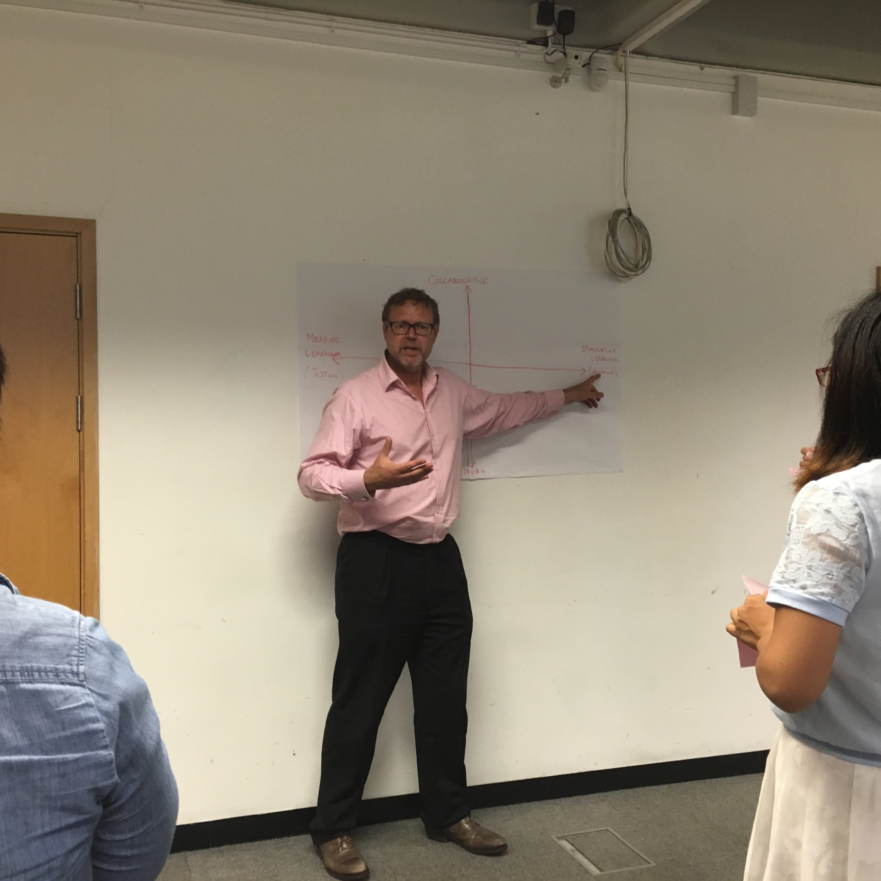
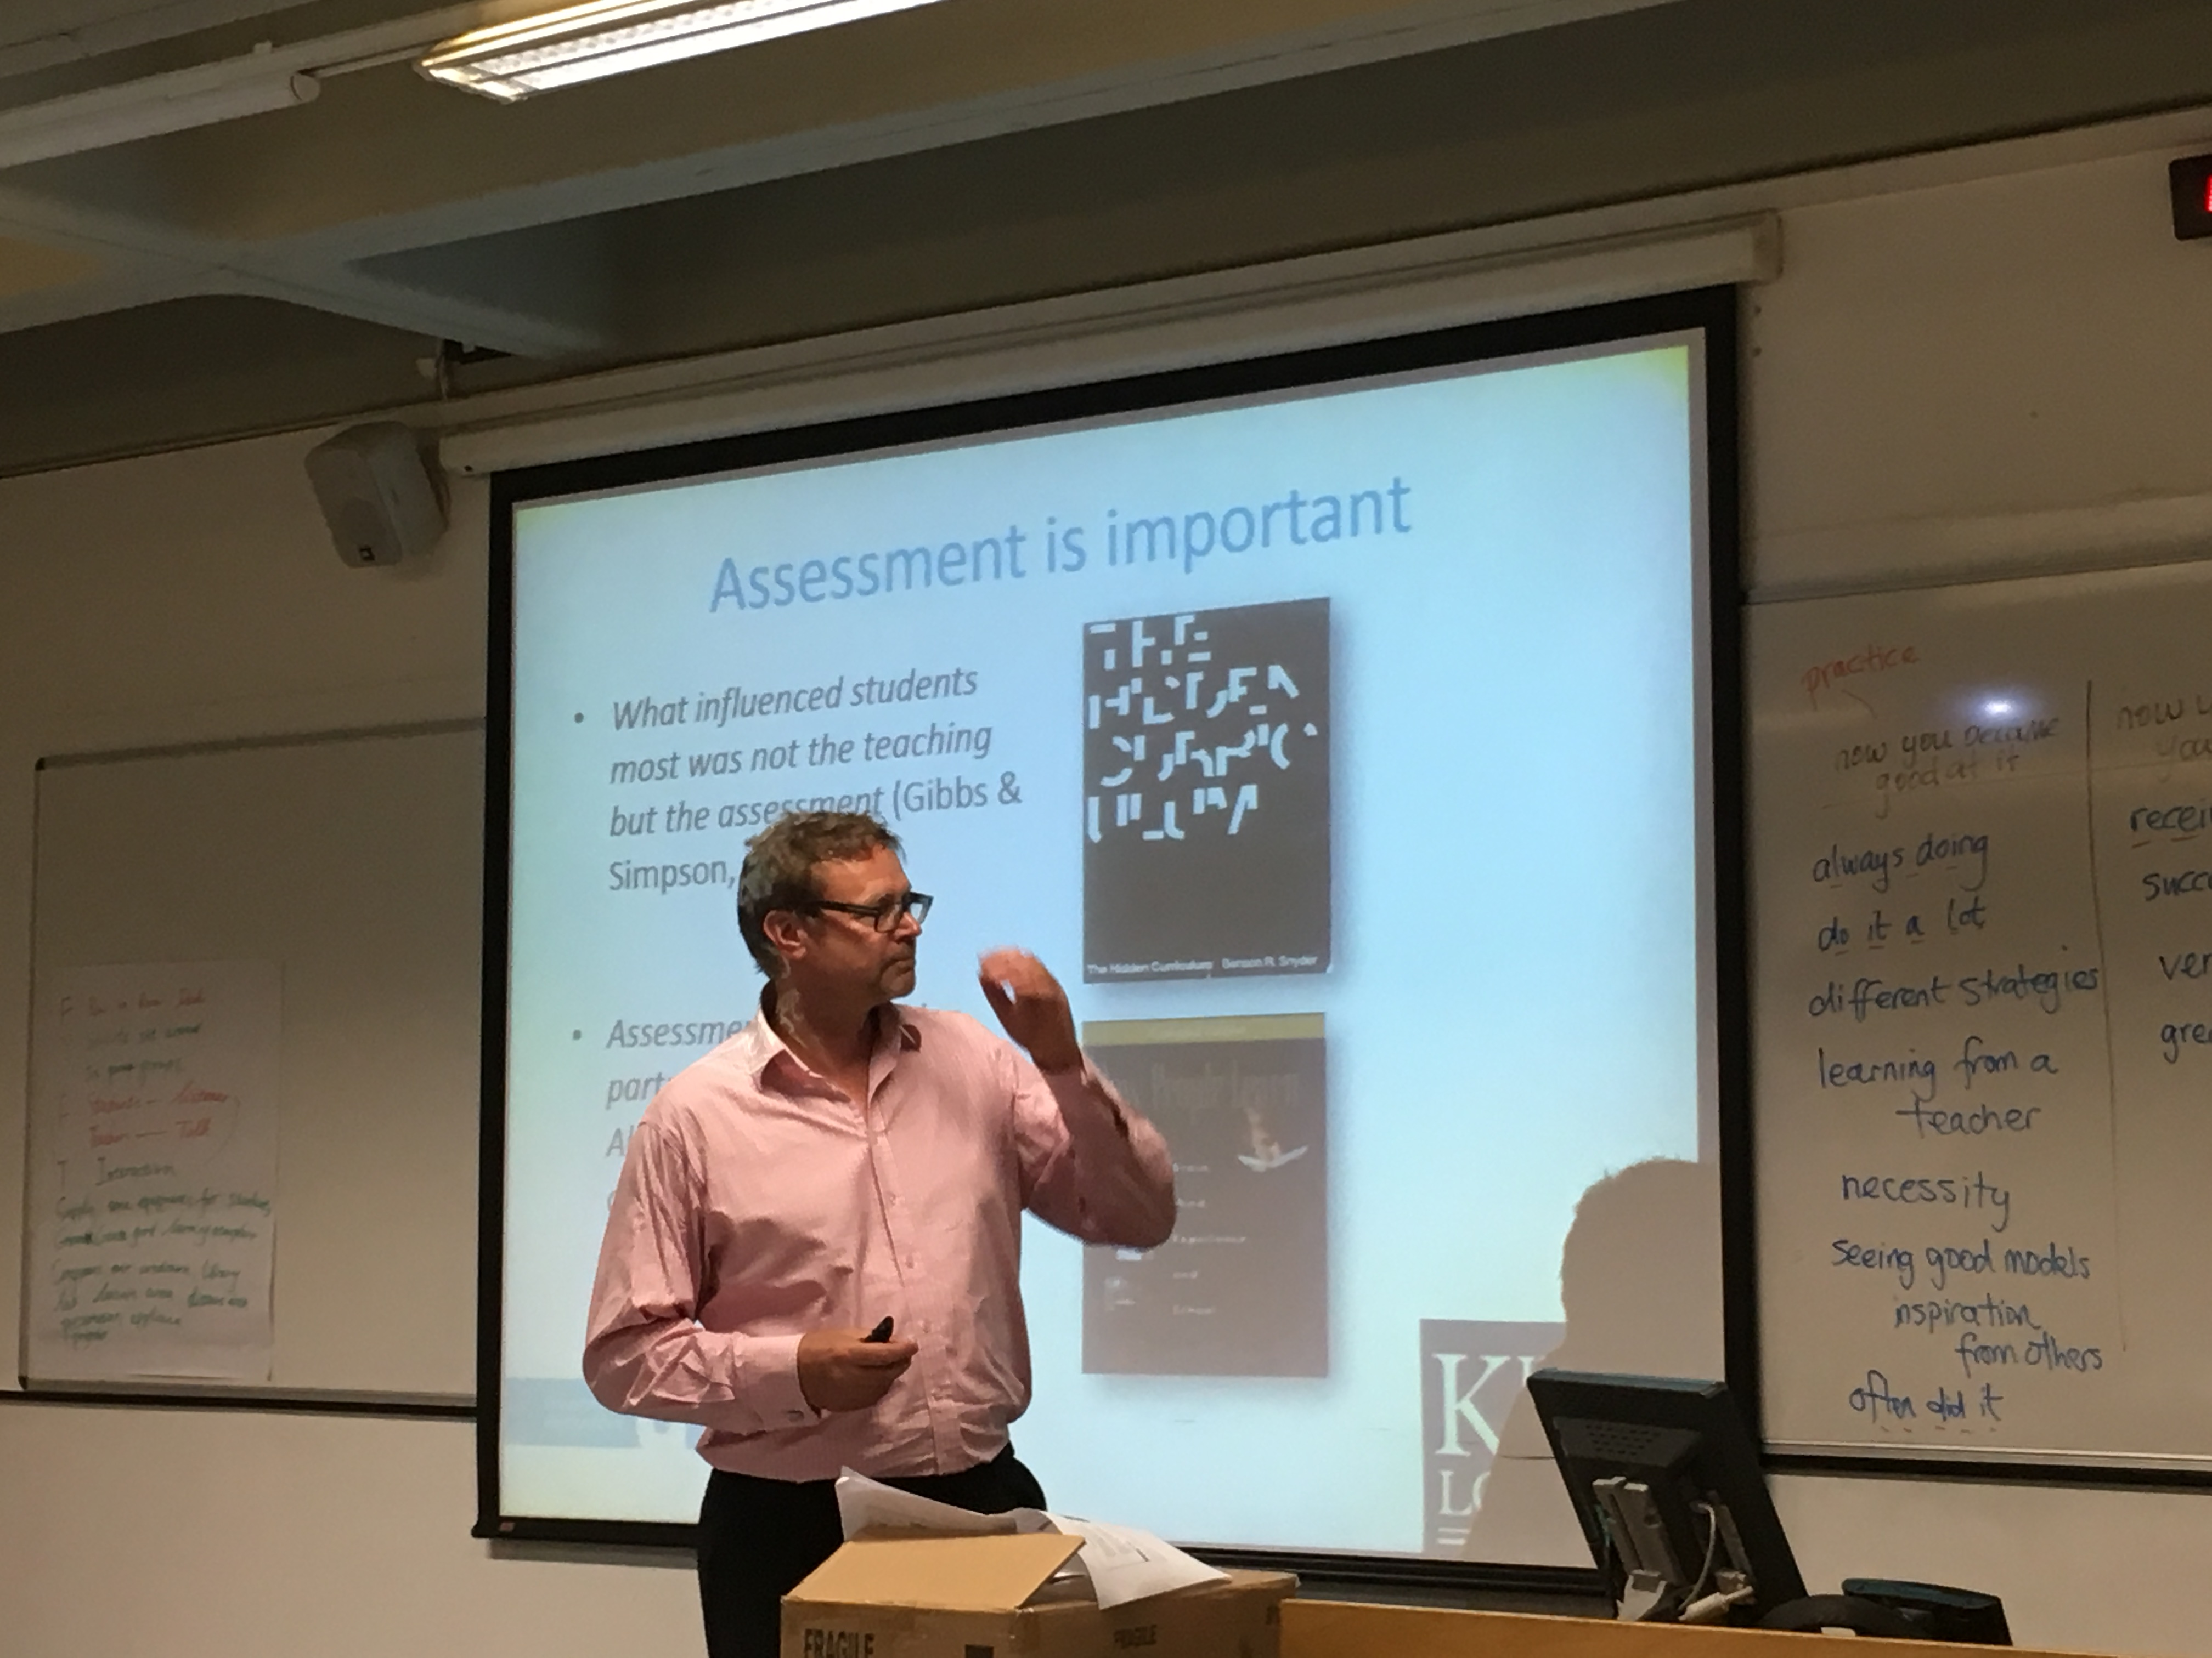
Cambridge

Slide 11
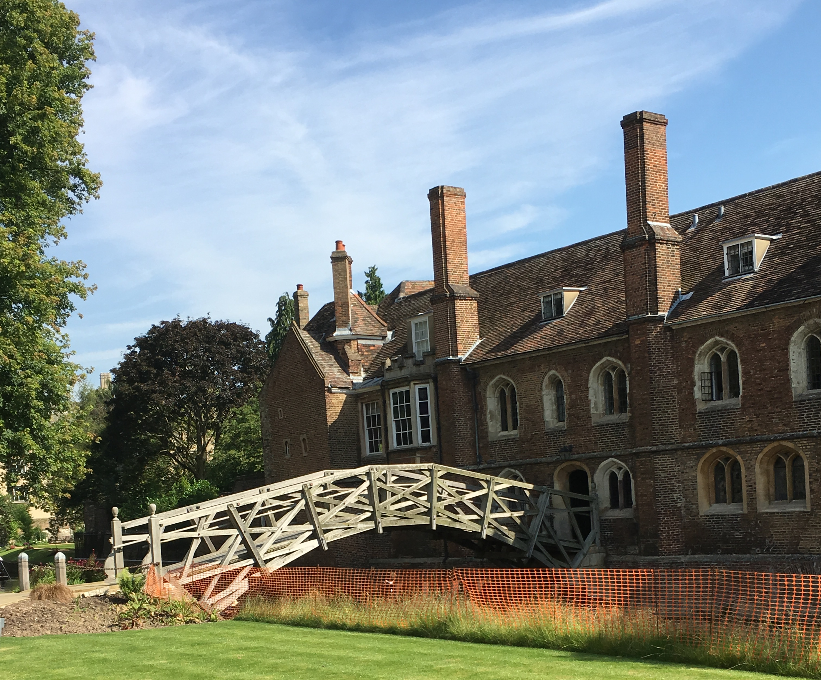
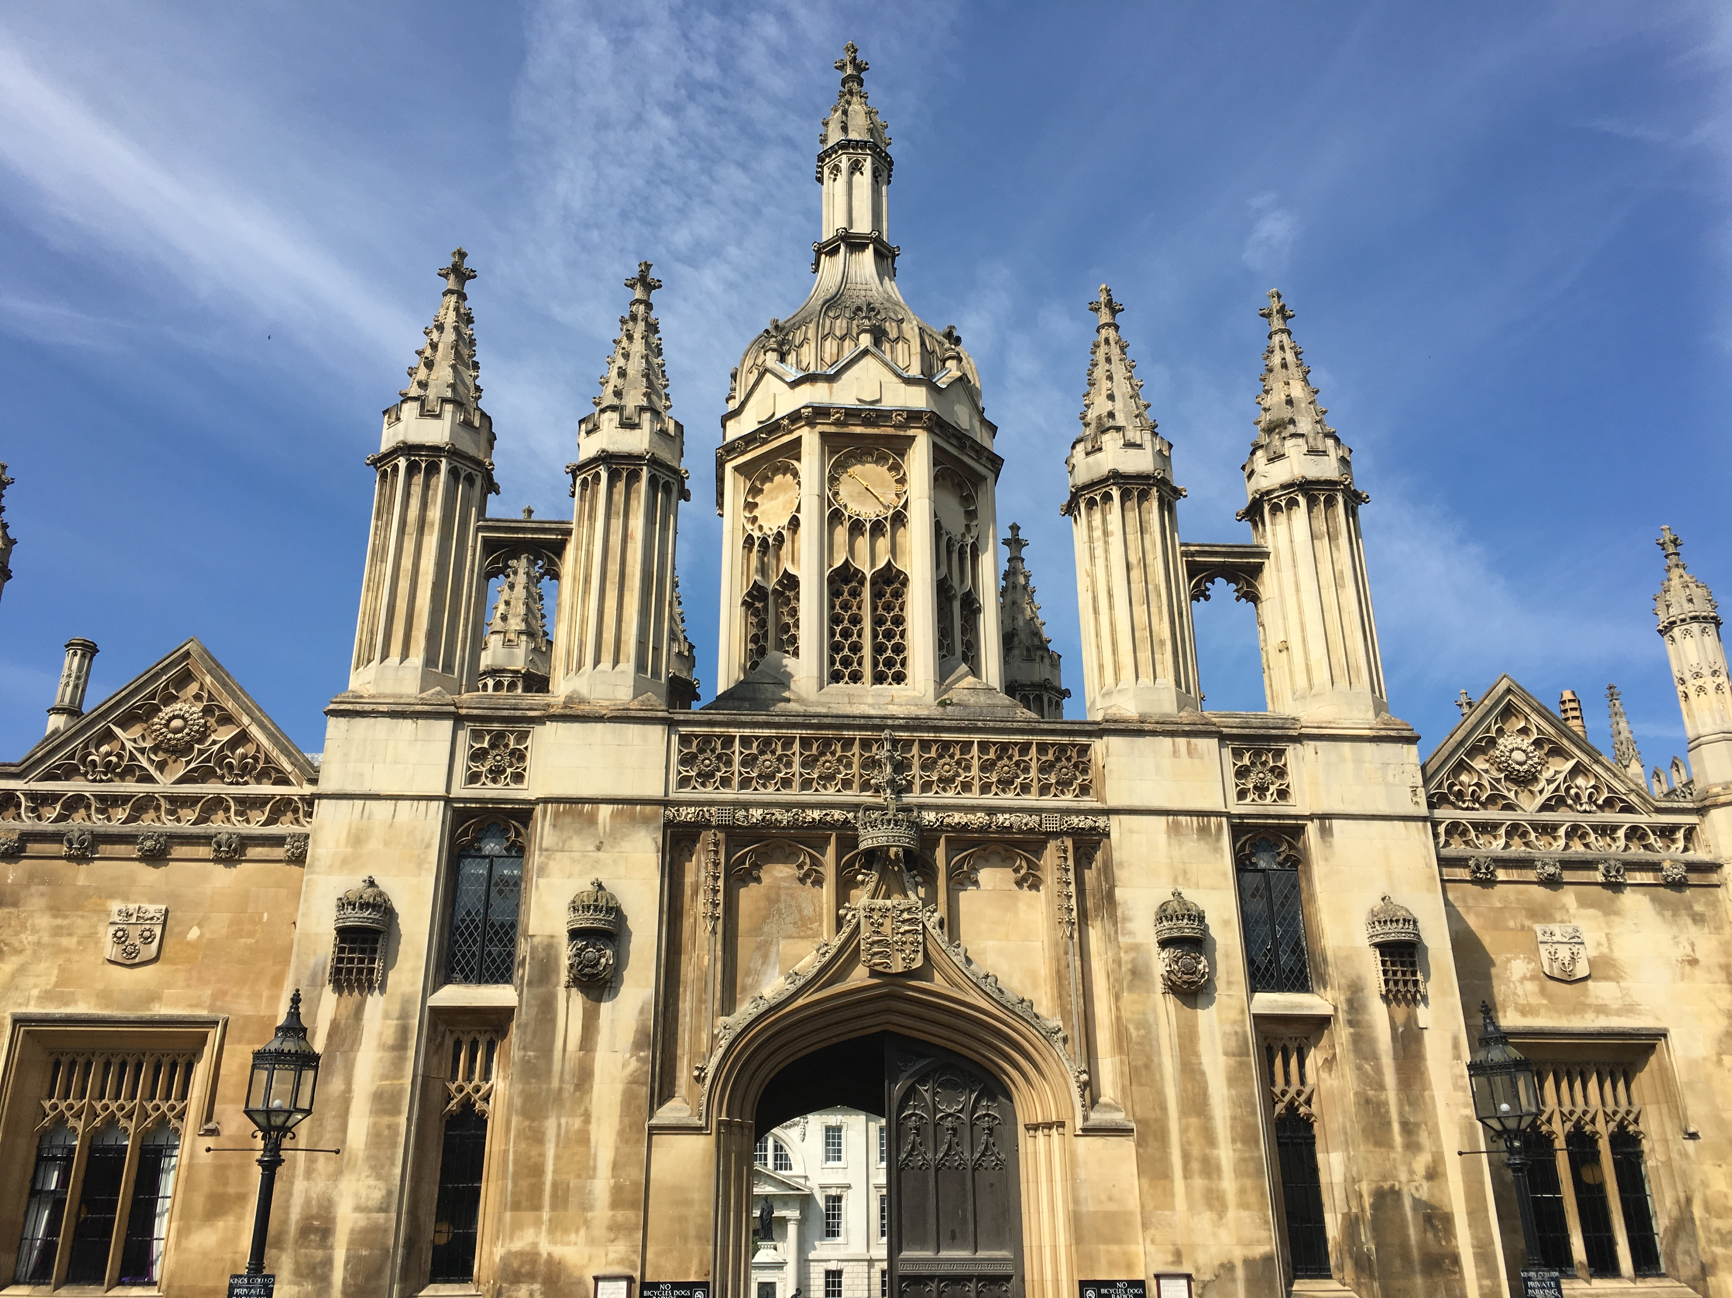
Cambridge

Slide 12

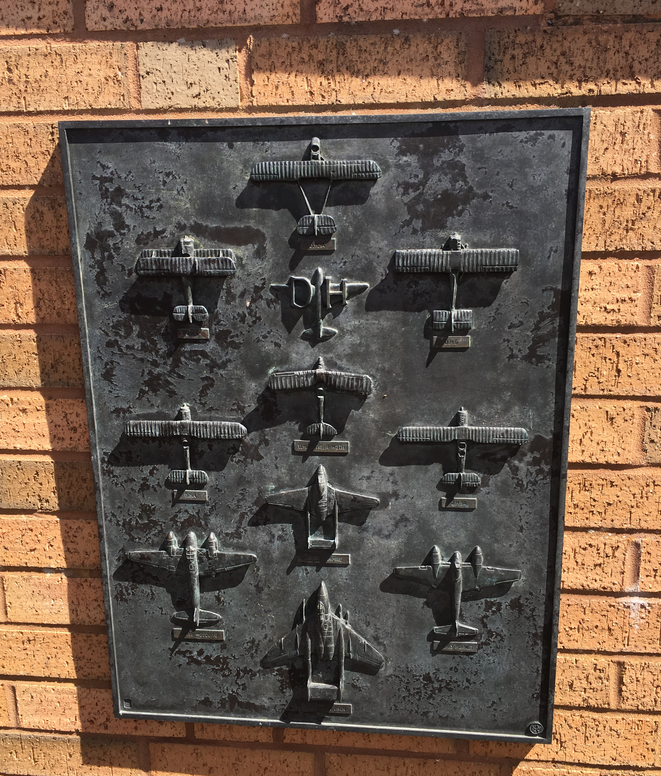
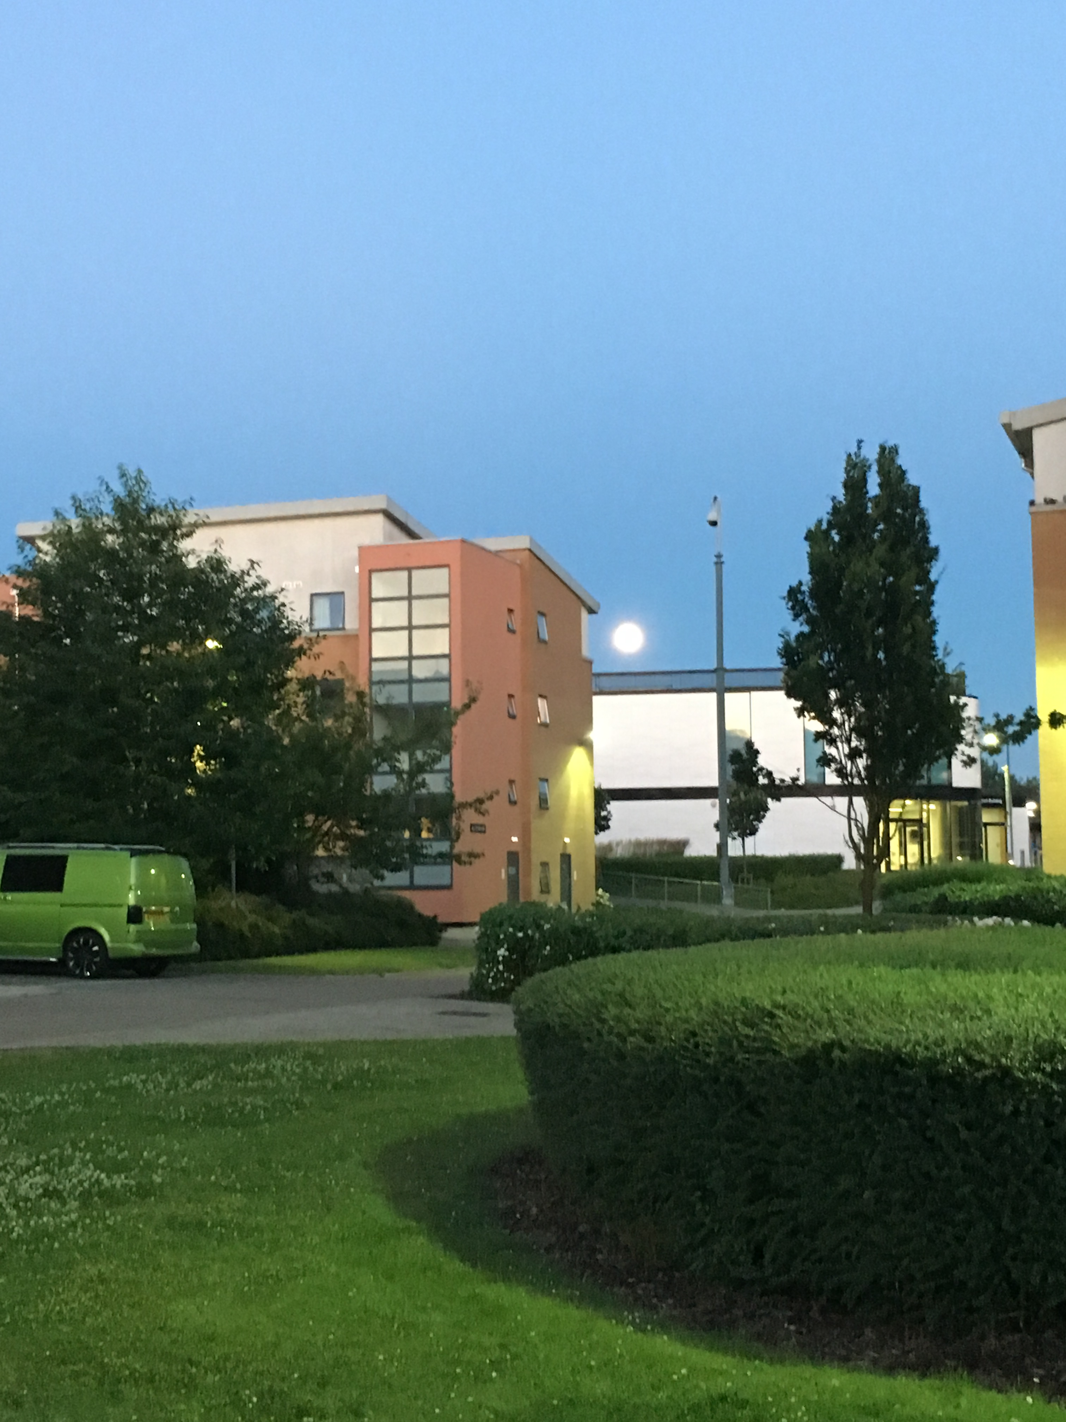
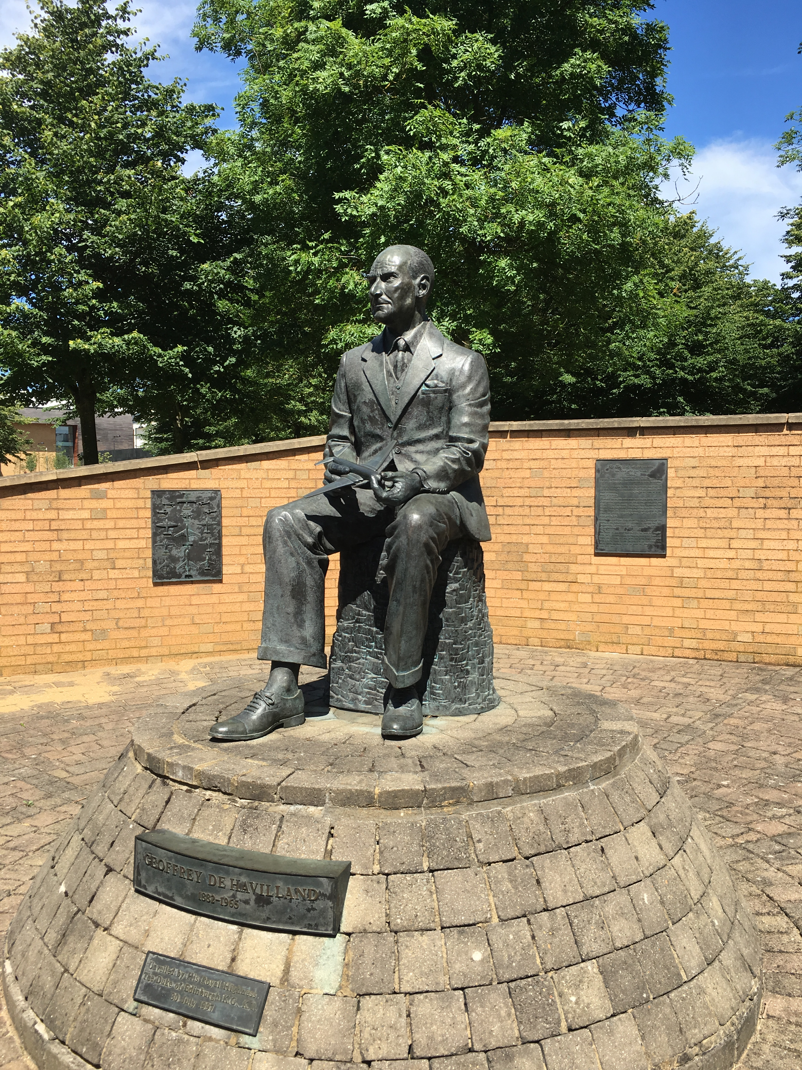
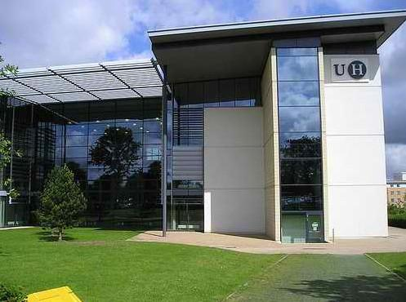
赫特福德大学

Slide 13
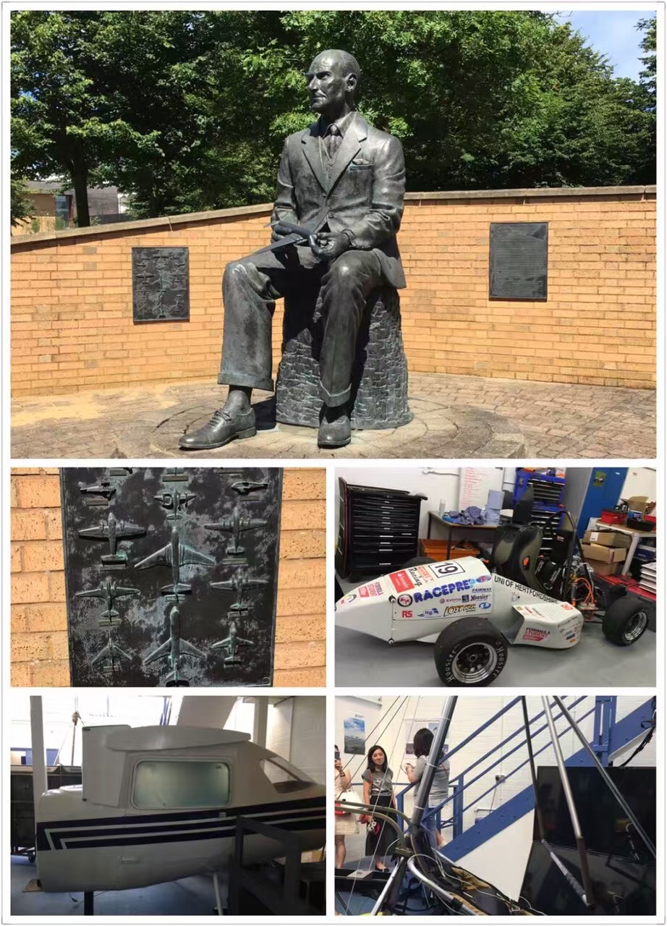
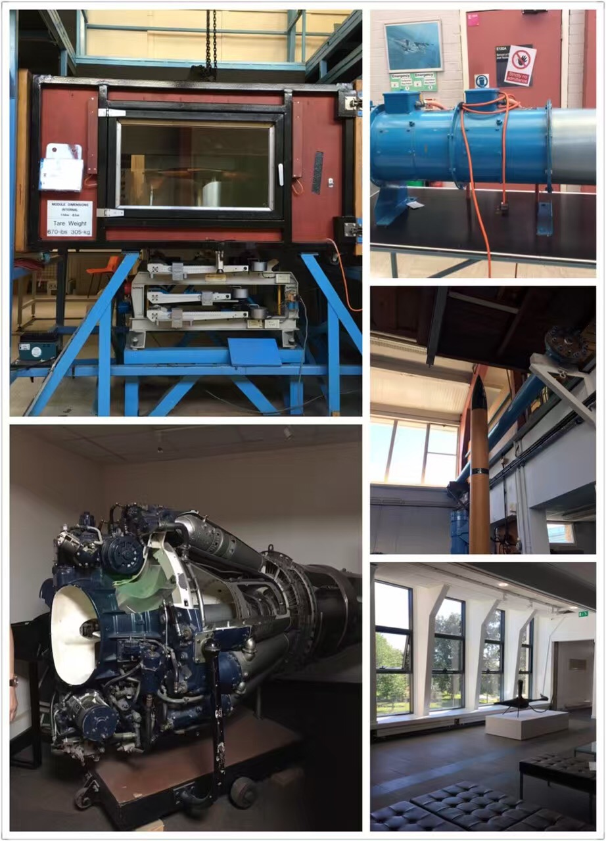
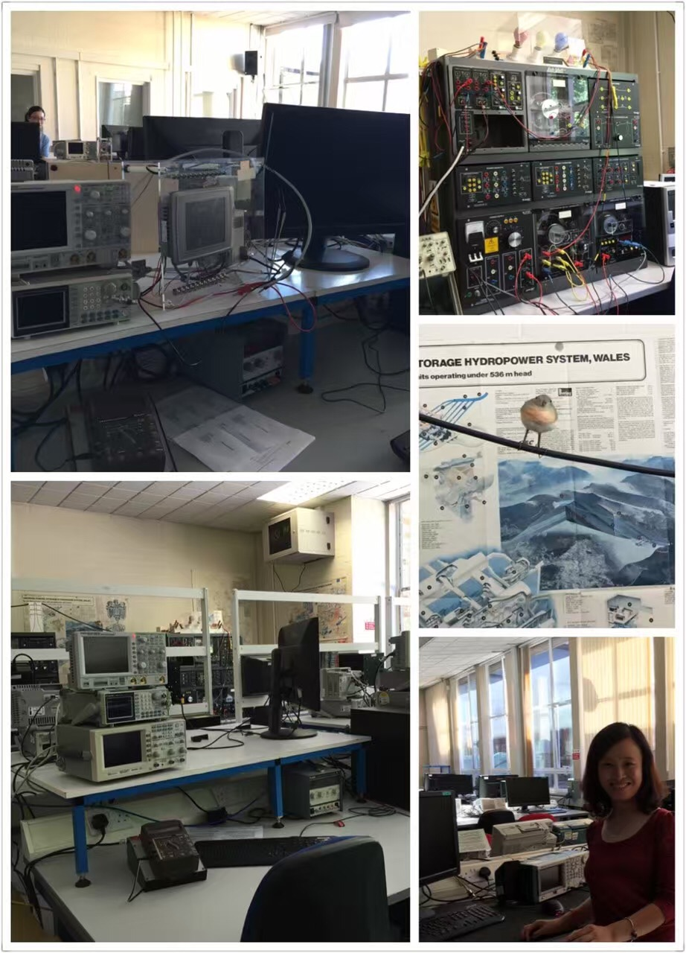
工程实践基地

Slide 14
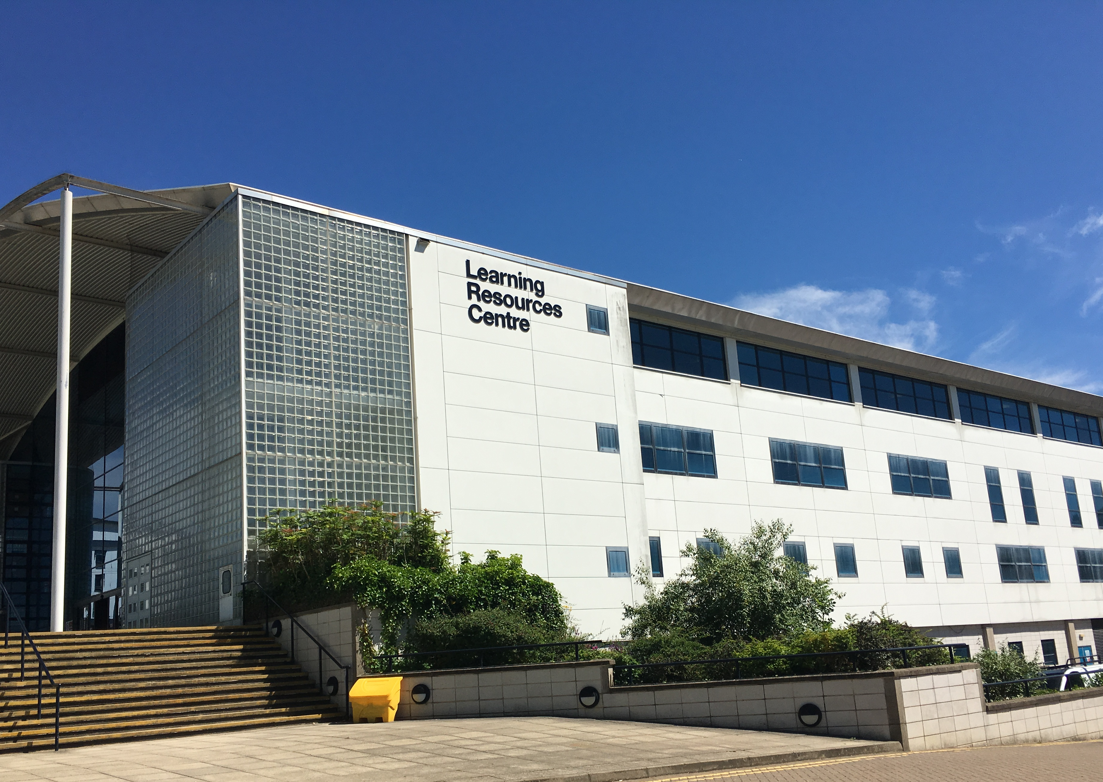
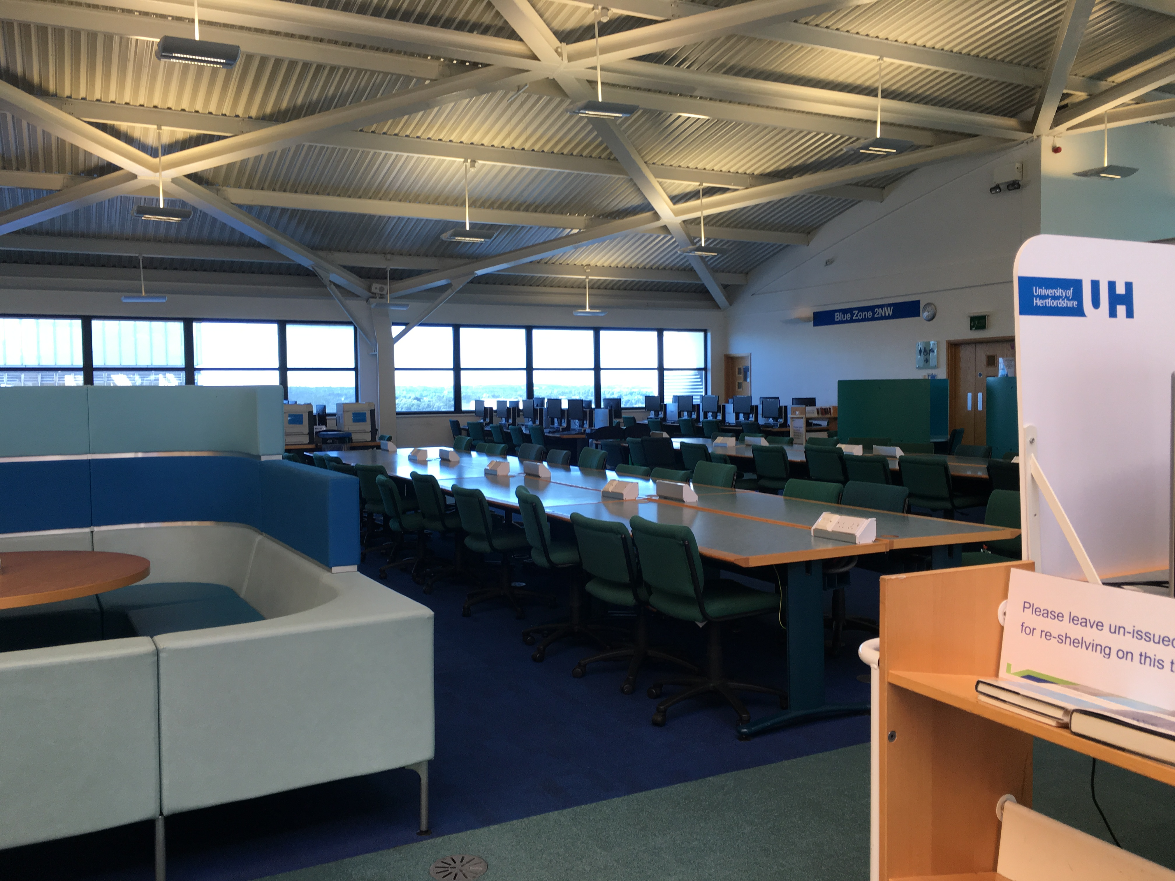
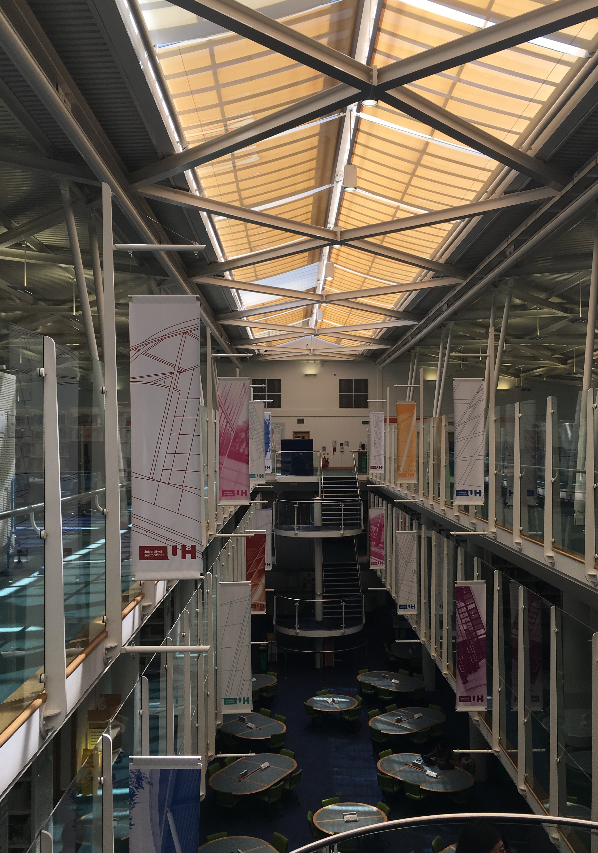
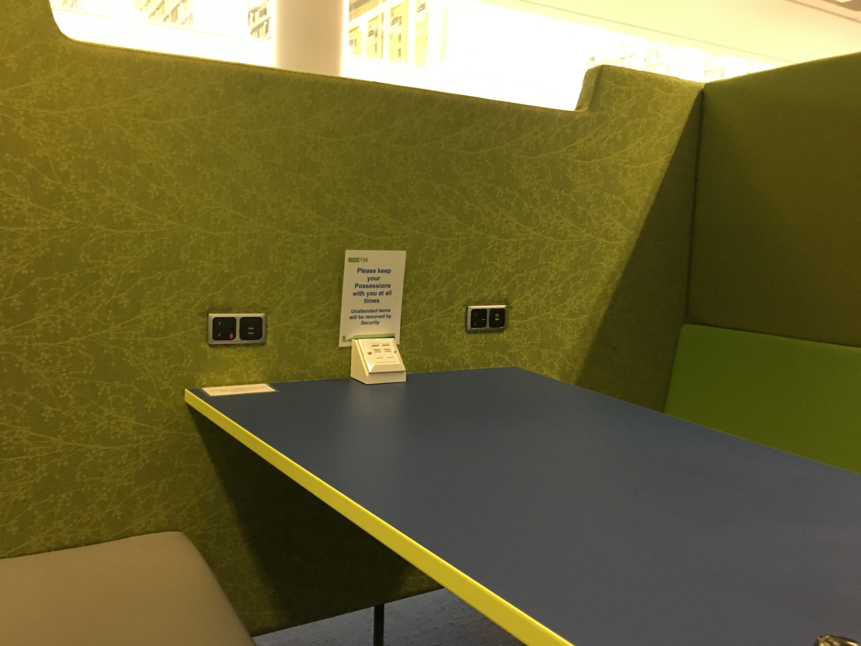
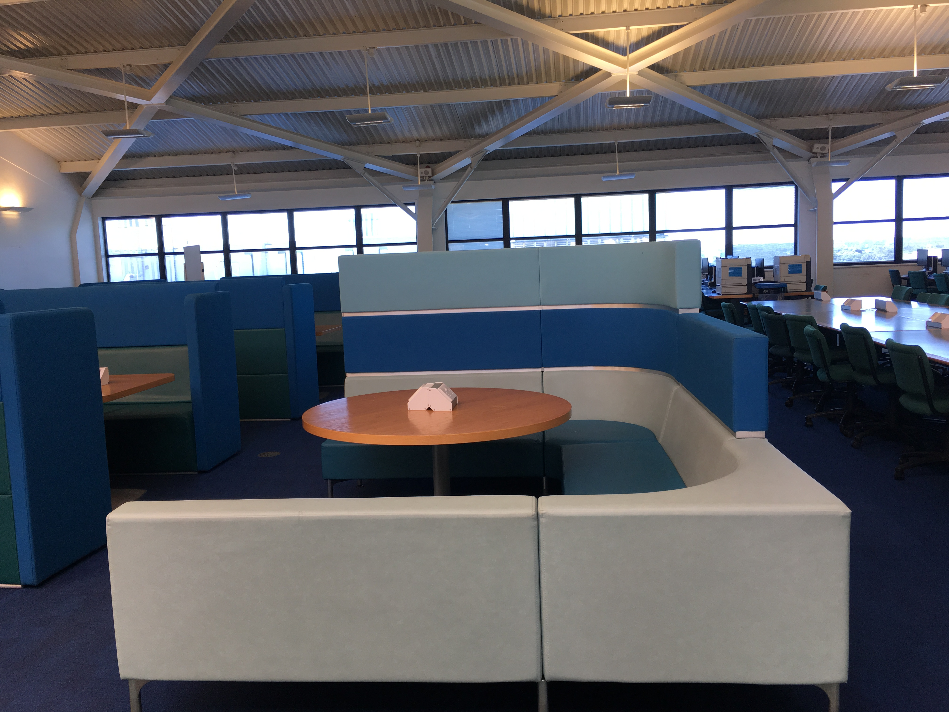
学习资源中心

Slide 15
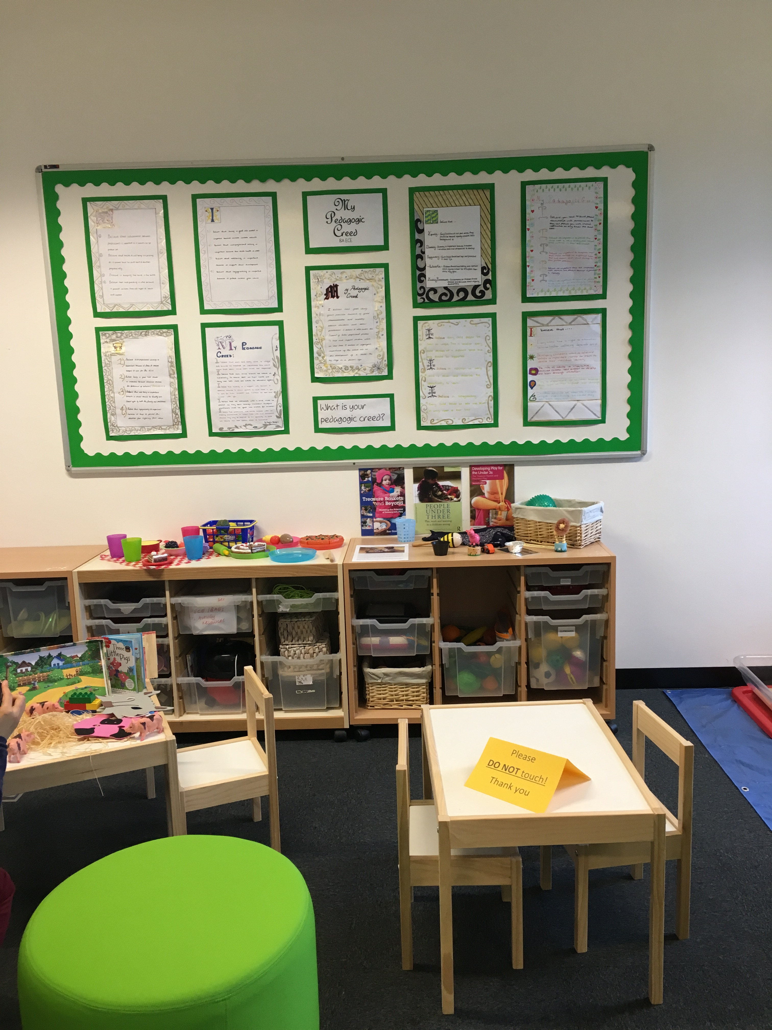
学前教育教室

Slide 16
英国的教育体系与高校
课堂教学方法
提高学习的积极性（Activity）
课程考核（Assessment）
小组学习（Group work）

Slide 17
How students learn - Activity
课堂教学方法——提高学习的积极性（Activity）
3 bullet points:
1st point-擅长什么 Think of something you are good at – it doesn’t have to be academic – singing, dancing, playing a sport, anything you like. Write it down on your post-it note.
2nd point –如何做到 Write a few words about how you became good at it
3rd point–如何知道 write a few words about how do you know you are good at it?
Notes:
So we have thought about the elements that can influence student learning but how do students learn? Clare is going to lead an activity to help us think about what learning is.
How students learn activity: (mark three bullets on post-it – demonstrate on flip chart)
1st point - Think of something you’re good at – it doesn’t have to be academic – singing, dancing, playing a sport, anything you like. Write it down on your post-it. Try to make writing legible!
2nd point – Write a few words about how you became good at it
3rd point – How do you know you’re good at it?
Swap post-it with person next to you. Read some out – record on flip chart – 2 columns: one for how became good, and one for how you know.
Reflect on flip chart responses – what’s the overriding ingredient? Practice/Trial/Error... Repetition... Compliments... Support... Increased self-confidence... Feedback?!
Feedback – important ingredient in learning.
All of these examples, you were very actively involved in the process: “learning is done by people not to them” (Race, 2001).

Slide 18
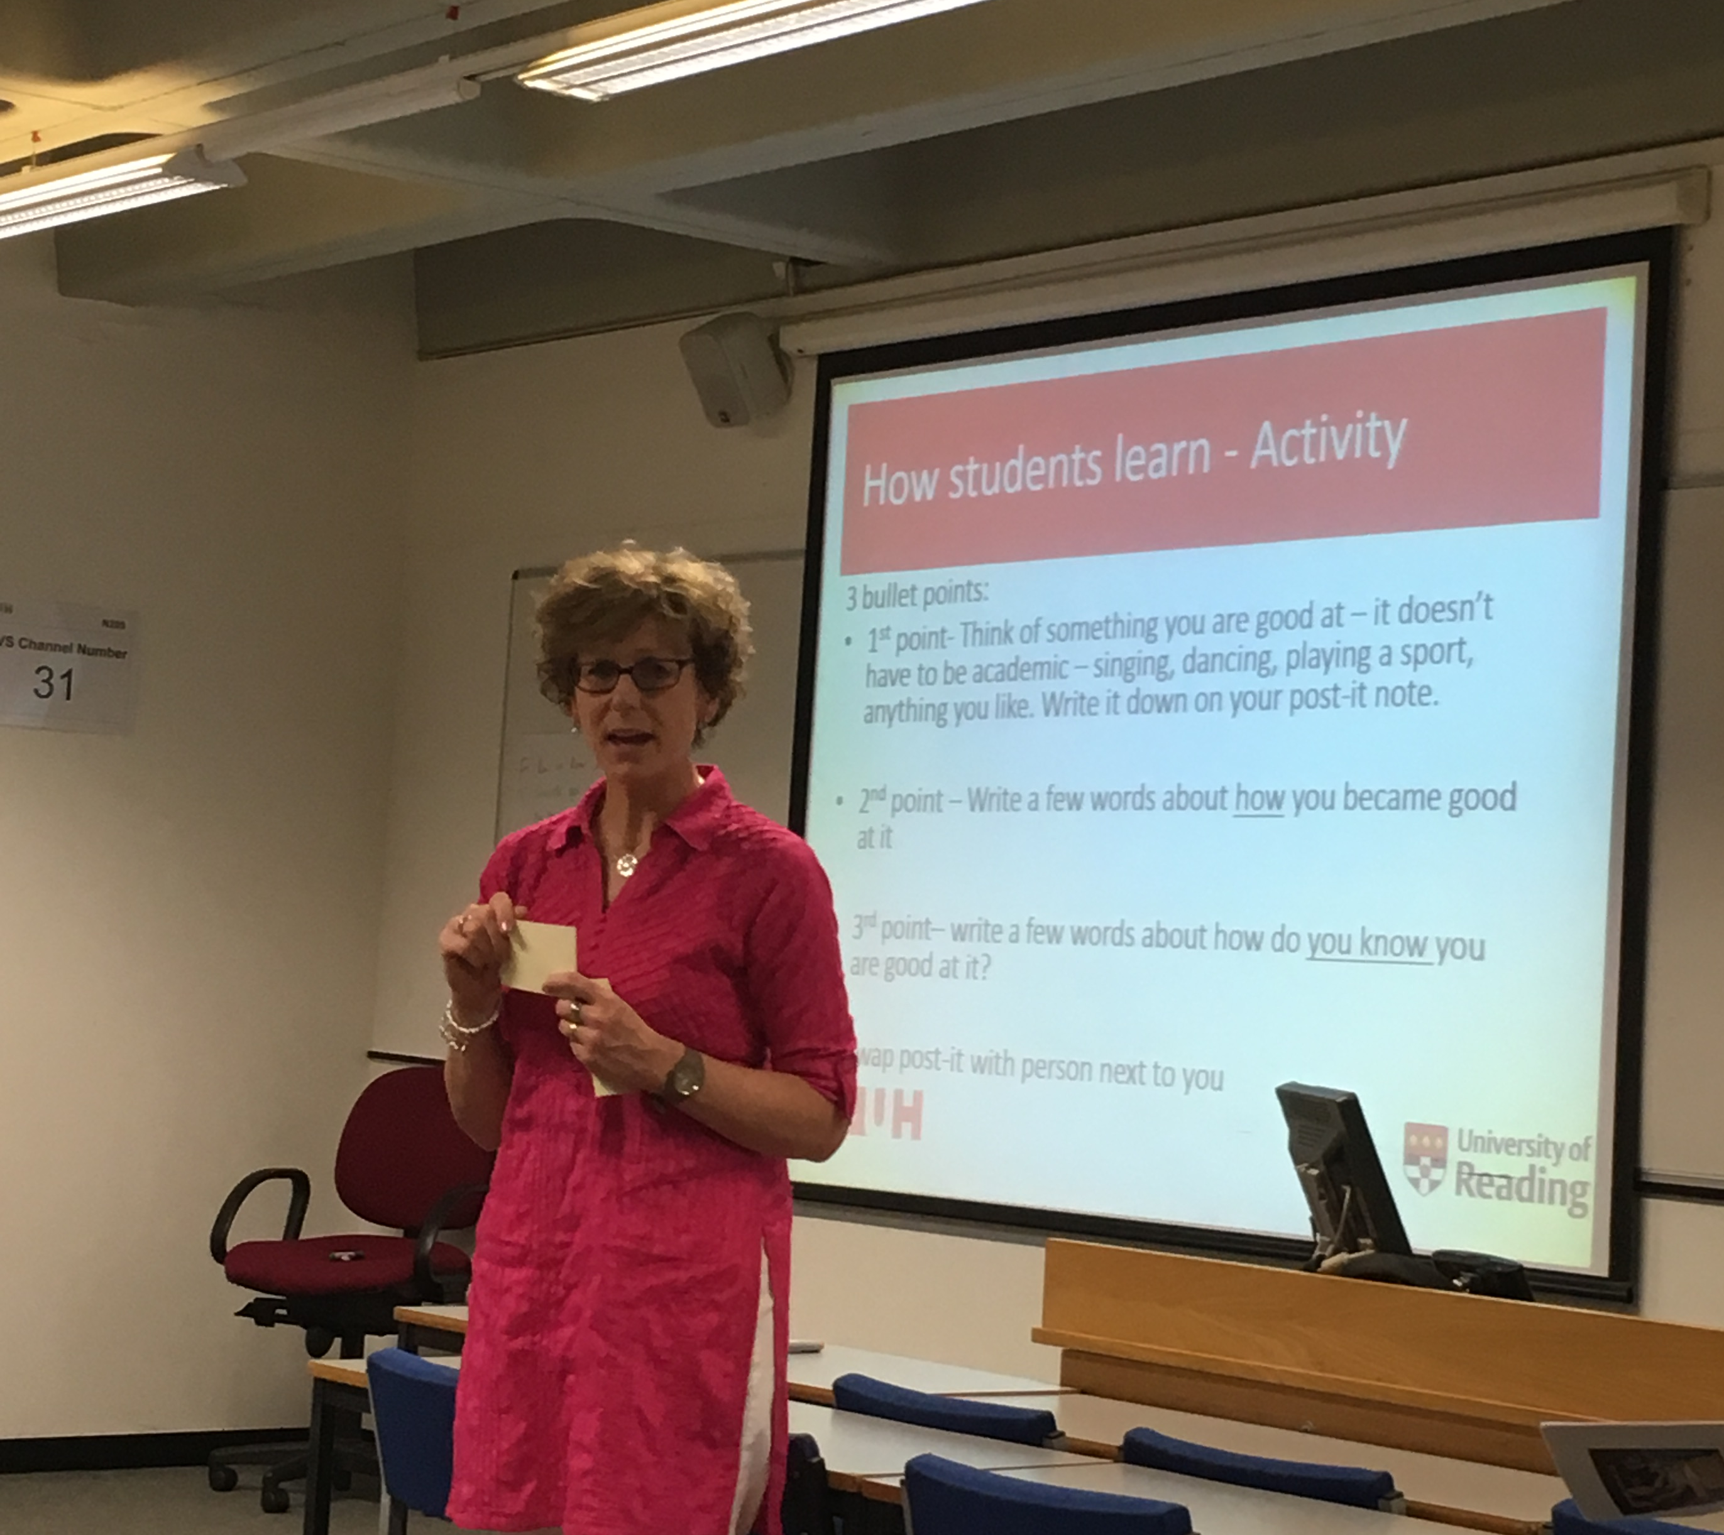
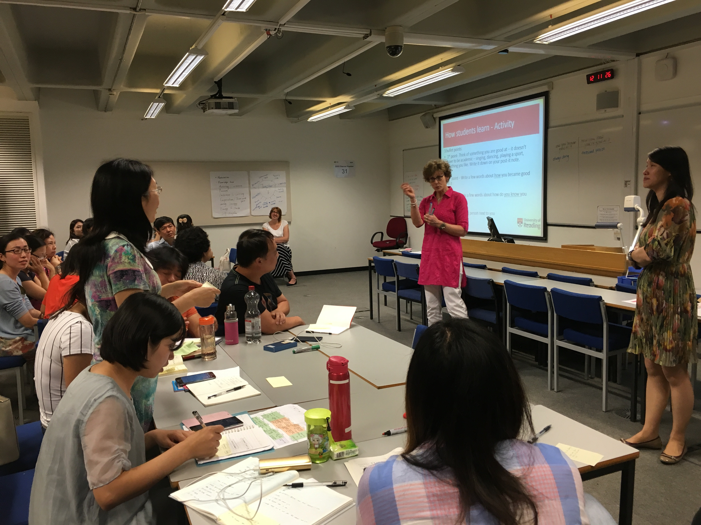
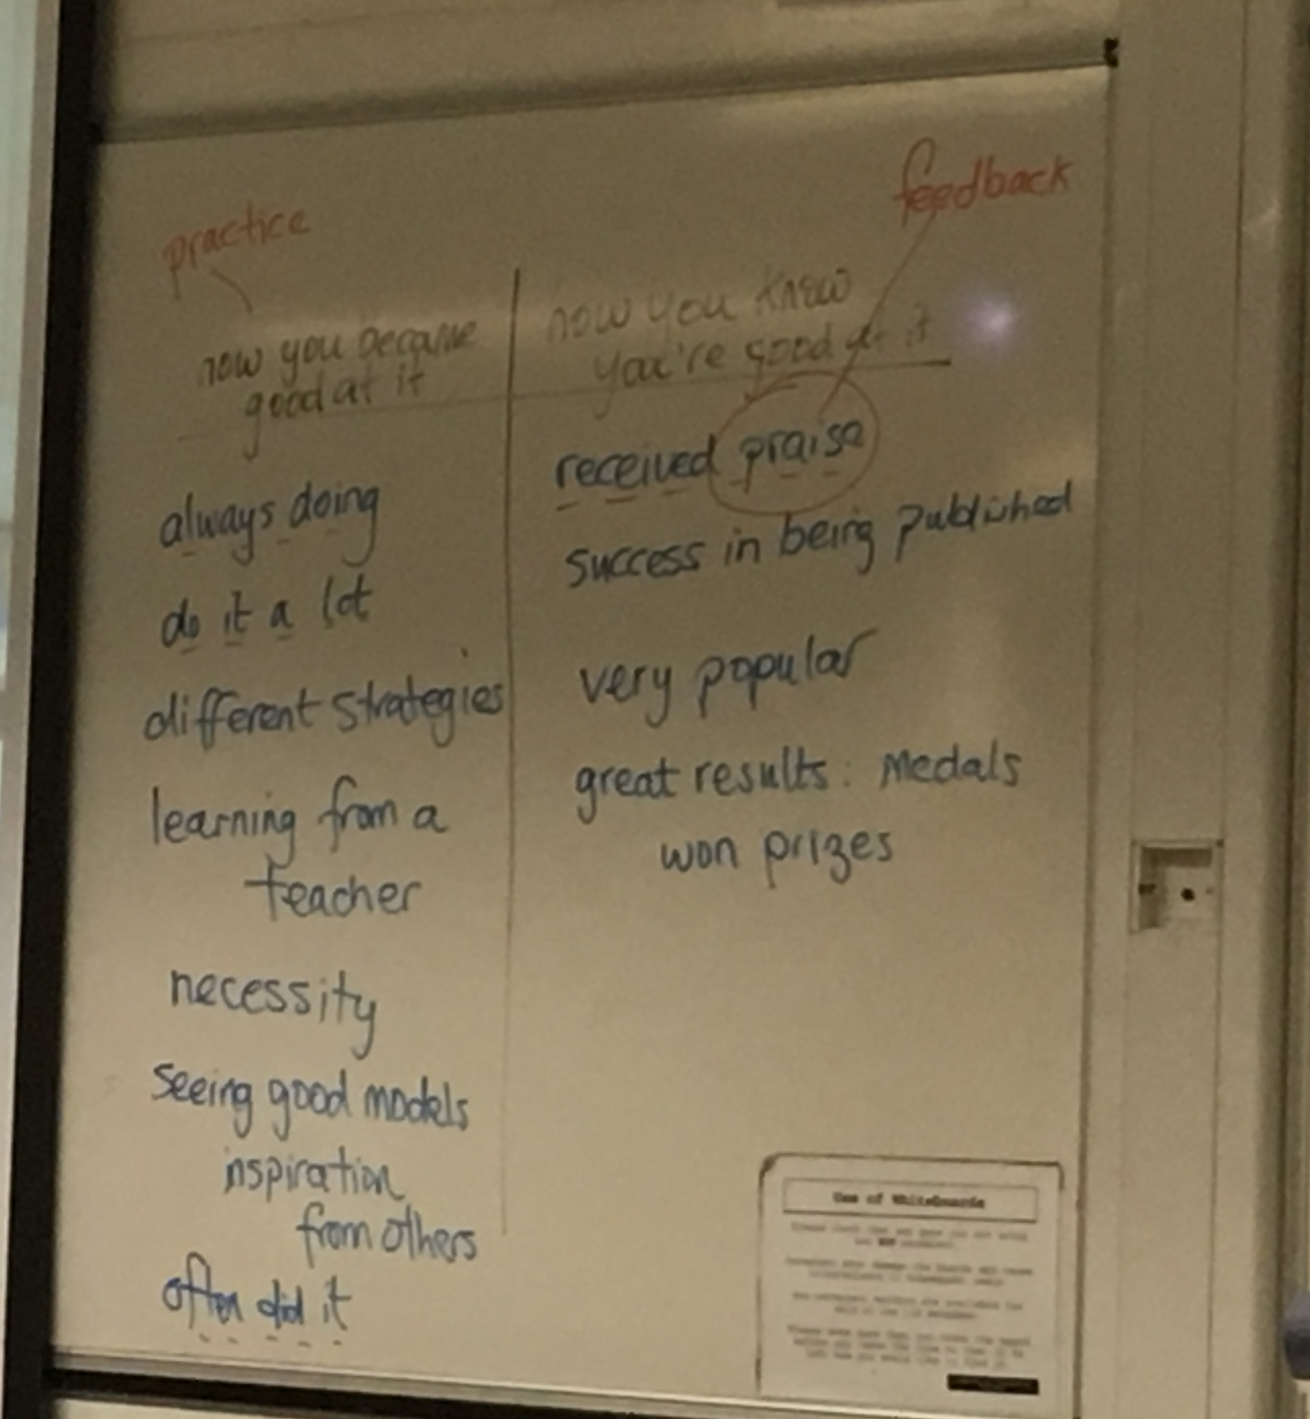

Slide 19
How you became good at it？

Slide 20
提高学习的积极性（Activity）
鼓励 Encourages active learning
合作 Develops reciprocity and cooperation among students
反馈 Encourages Gives prompt feedback
多练习 Emphasises time on task
尊重不同的方式 Respects diverse talents and ways of learning

Slide 21

Lectures and seminars, still…
Notes:
We talk a lot about active learning, and student-centred learning in HE in the UK, but actually… many students still learn through attending lectures. So this is very traditional, but still very popular. Students come to university expecting to attend lectures.
As our student numbers increase, lectures are likely to remain… it’s an efficient way to reach large numbers!

Slide 22

…but more interactive
Notes:
But the nature of lectures have changed in recent years, to become more interactive, to enable the active learning we talk so much about.
So lecturers have little tricks up their sleeve to involve students more actively, for example:
Break it up – change the pace of the lecture to keep students alert… e.g. watch a video clip
Test them – you ask them questions, to monitor their understanding – (standing up example)
Have them contribute – allow your students to ask questions – vary the way you do so, e.g. hands up, use post-its
Make them think – buzz groups (demonstrate this during the following slides)

Slide 23
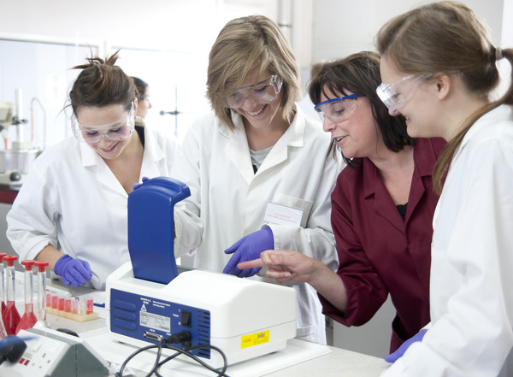
…more hands on learning
Notes:
Experiential learning is a fundamental approach in both schools and universities in the UK.
You can see from this picture that it can work very well with science subjects.
So here the teacher is more of a facilitator, wandering amongst the students, checking they’re okay, chatting with them, providing helpful input. These sorts of activities are often done in groups which encourages discussion amongst students.
They also help to break down barriers between teachers and students – students can take some control of their learning and develop independence, while the teacher is promoting and supporting this development.

Slide 24
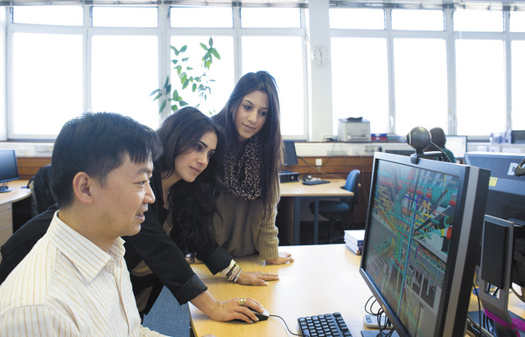
…collaborative learning
Notes:
Many group projects require students to get together beyond the classroom in order to complete their work. Sometimes, they’re assessed as a group too – so they’ll share a group mark. This can be quite challenging for both the students and the tutor!
They might do a lot of this work virtually, using email, Facebook, Google Docs, or the VLE, like Blackboard, or they might meet face to face after classes.
We can clearly see this type of learning is reflected in the learning spaces that universities are creating for their students…

Slide 25
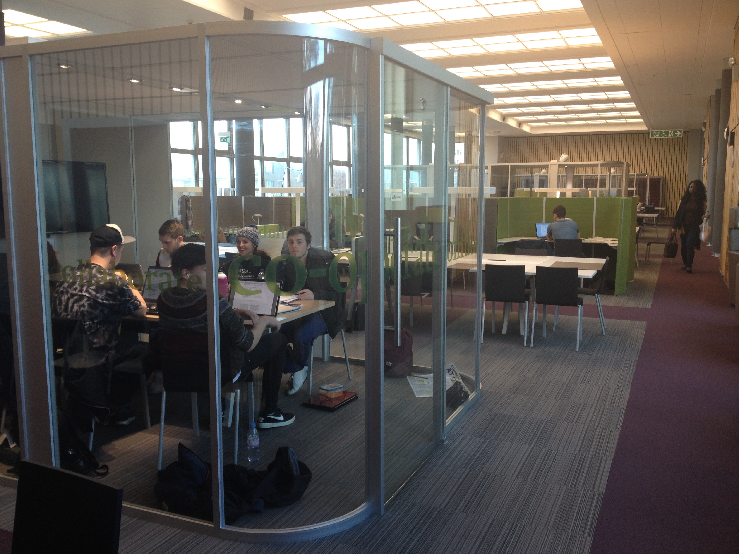
… and collaborative learning spaces
Notes:
For example in the way university libraries are being re-designed.

Slide 26

…independent learning
Notes:
A key goal in HE is to foster independent learning – to encourage students to think for themselves. It’s seen as one of the big differences between school and university. But they can’t do it alone… to achieve this, we, as teachers, have to provide lots of scaffolding for them – in other words, lots of support at the beginning, in their first year of university, and then less and less as they gain greater academic independence.

Slide 27
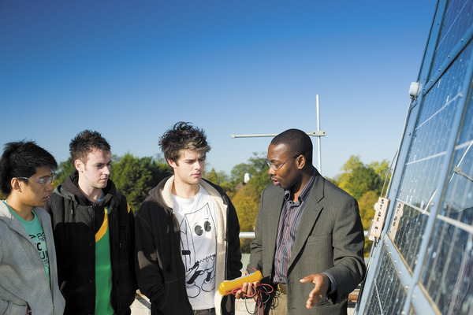
…learning beyond the classroom
Notes:
There’s an emphasis on real-world learning too, on learning that’s meaningful, and relevant to real-world problems and scenarios.
Sometimes, the best way to achieve this is to go beyond the classroom and do field based learning – to see and feel the real thing. Students will often say that this type of learning has great impact.

Slide 28
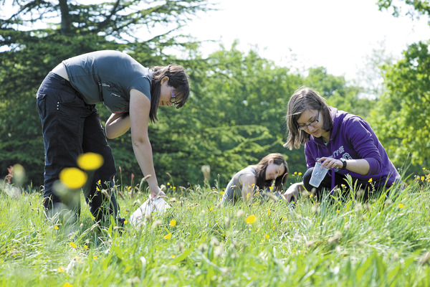
…active involvement in learning
Notes:
And to really get stuck in… to be active not just as learners, but as explorers… discovering, collecting samples, gathering data. This type of work often feeds into project work or dissertations, including for undergraduates.
It’s common for students to go on field trips with their tutor a long way from home, visiting other countries including beyond Europe. So a Biology student might visit Iceland, and a History student might visit Rome in Italy.

Slide 29
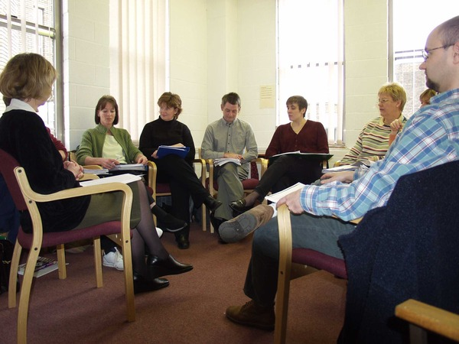
…reflective learning
Notes:
Great deal of attention given to reflective approaches to learning in HE now.
The idea is that it can help learners to internalise ideas and theories, to engage with them more deeply.
Reflective practice encourages learners to think about why something is important or helpful, or relevant.
So here’s an example…
I could ask you whether you’ve all enjoyed this session. You might answer yes, or no (!)
But instead, if I ask you ‘What has been especially interesting or helpful for you, and why?’ …then I’m encouraging you to be more reflective.
(If time, do this as a real activity – demonstrating use of post-its referred to earlier on slide 8).

Slide 30
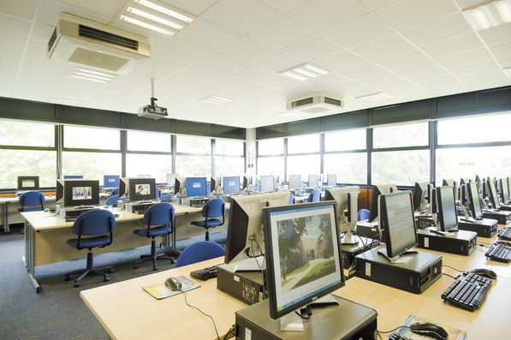
…distance learning
Notes:
Explosion in distance learning – referred to also as technology enhanced learning, TEL – you’re going to be having a session about this with Helen and Mark in a couple of days, so the only interesting point to mention here is that the arrival of technology has opened up new and exciting possibilities in terms of pedagogical approaches, particularly when teaching to very large numbers, but the pace of change is hugely challenging as technology develops so quickly!

Slide 31
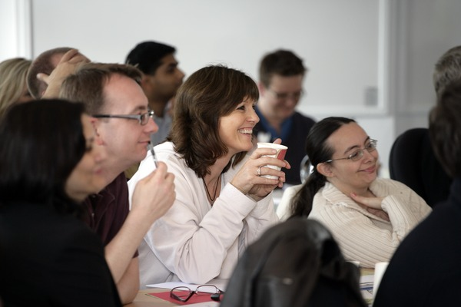
…life long learning
Notes:
This has really changed in my lifetime. The oldest PG student currently registered at the University of Reading is 83 ☺. You’re never too old to learn…
(Can get them to guess the age if there’s time)
This perhaps also reflects the changing world we live in – we all need to be more flexible now.

Slide 32
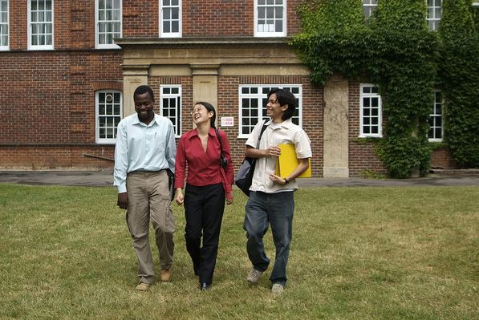
…international learning environment
Notes:
Universities in the UK have been welcoming international students for many years, but the numbers have dramatically increased in the last 10-15 years. International students pay a lot of money to study in the UK - in recent years, universities have paid greater attention to the international student experience, and try harder to ensure that international students have a positive experience and enjoy equal opportunities to home students.
If time – quick buzz group activity – turn to their partner and have a quick chat to decide on a question they’d like to ask us at the end. Demonstrating buzz groups.

Slide 33
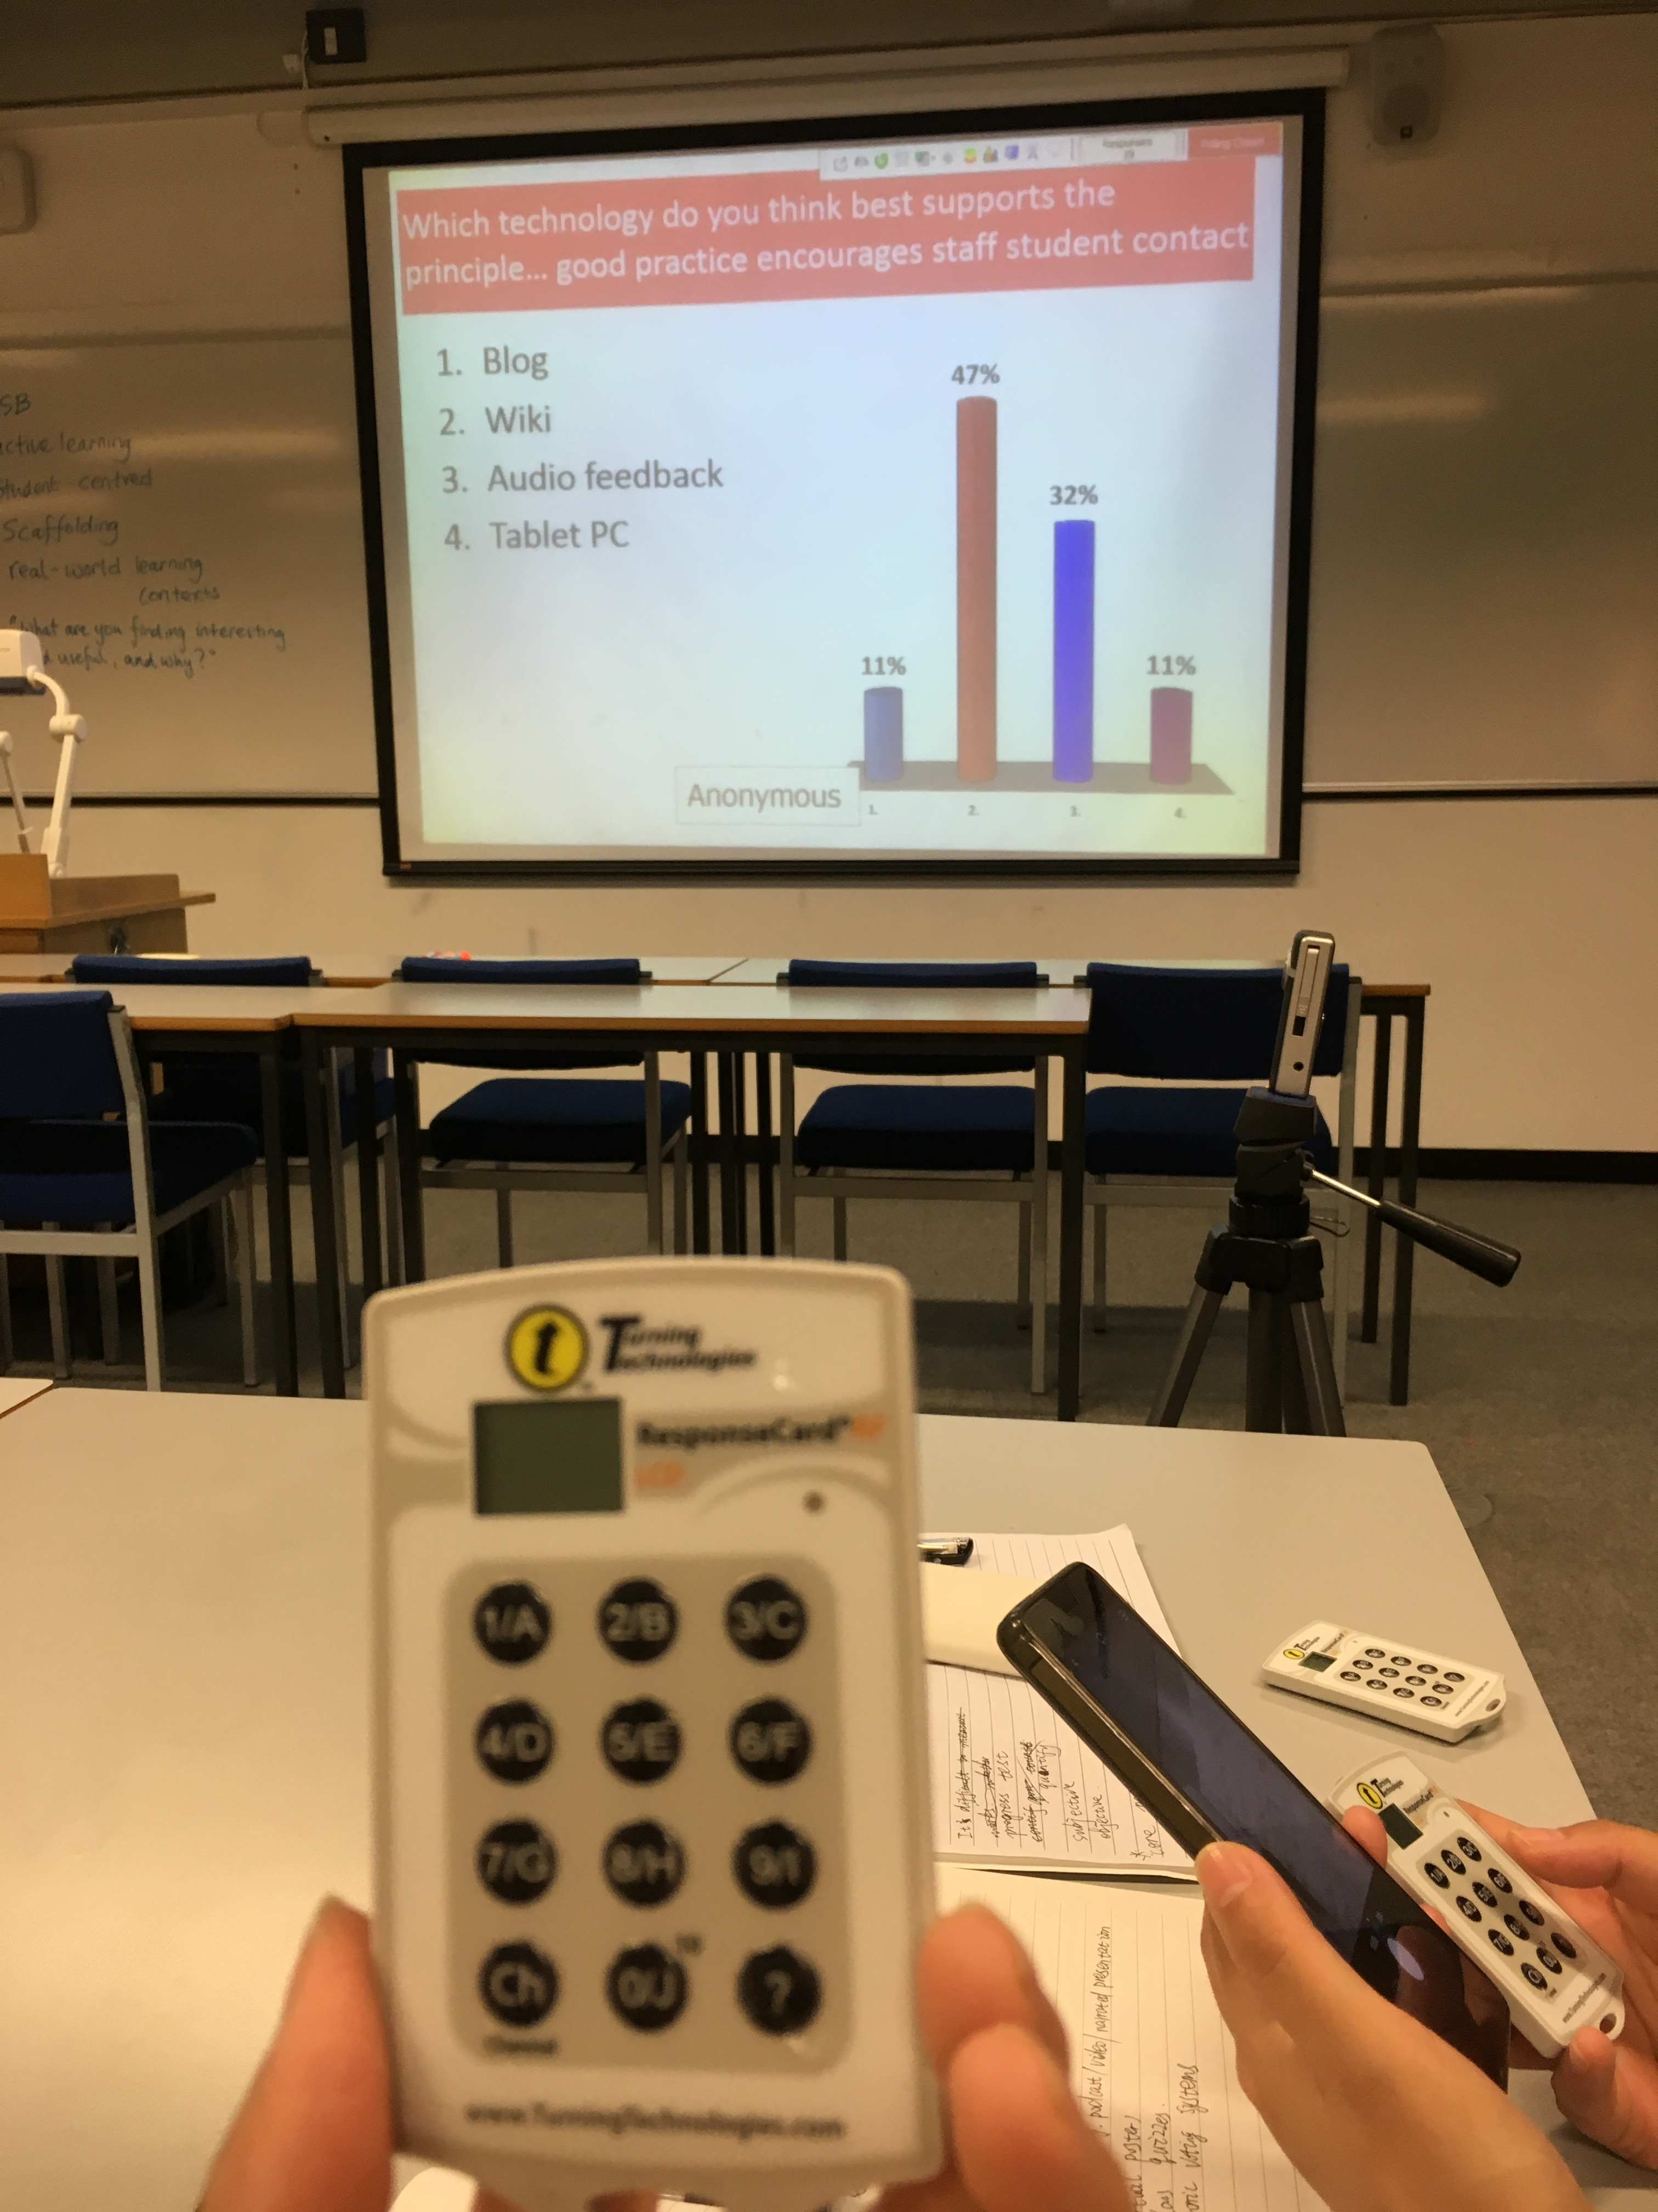

Slide 34
英国的教育体系与高校
课堂教学方法
提高学习的积极性（Activity）
课程考核（Assessment）
小组学习（Group work）

Slide 35

课堂教学方法——课程考核（Assessment）
1. 以课程为中心的教学方式
2. 考核比教学更影响学生
3. 考核方式需要多样化

Slide 36
What types of assessment do you use?
Collaborative
Testing learning
Ongoing learning
Individual

Slide 37
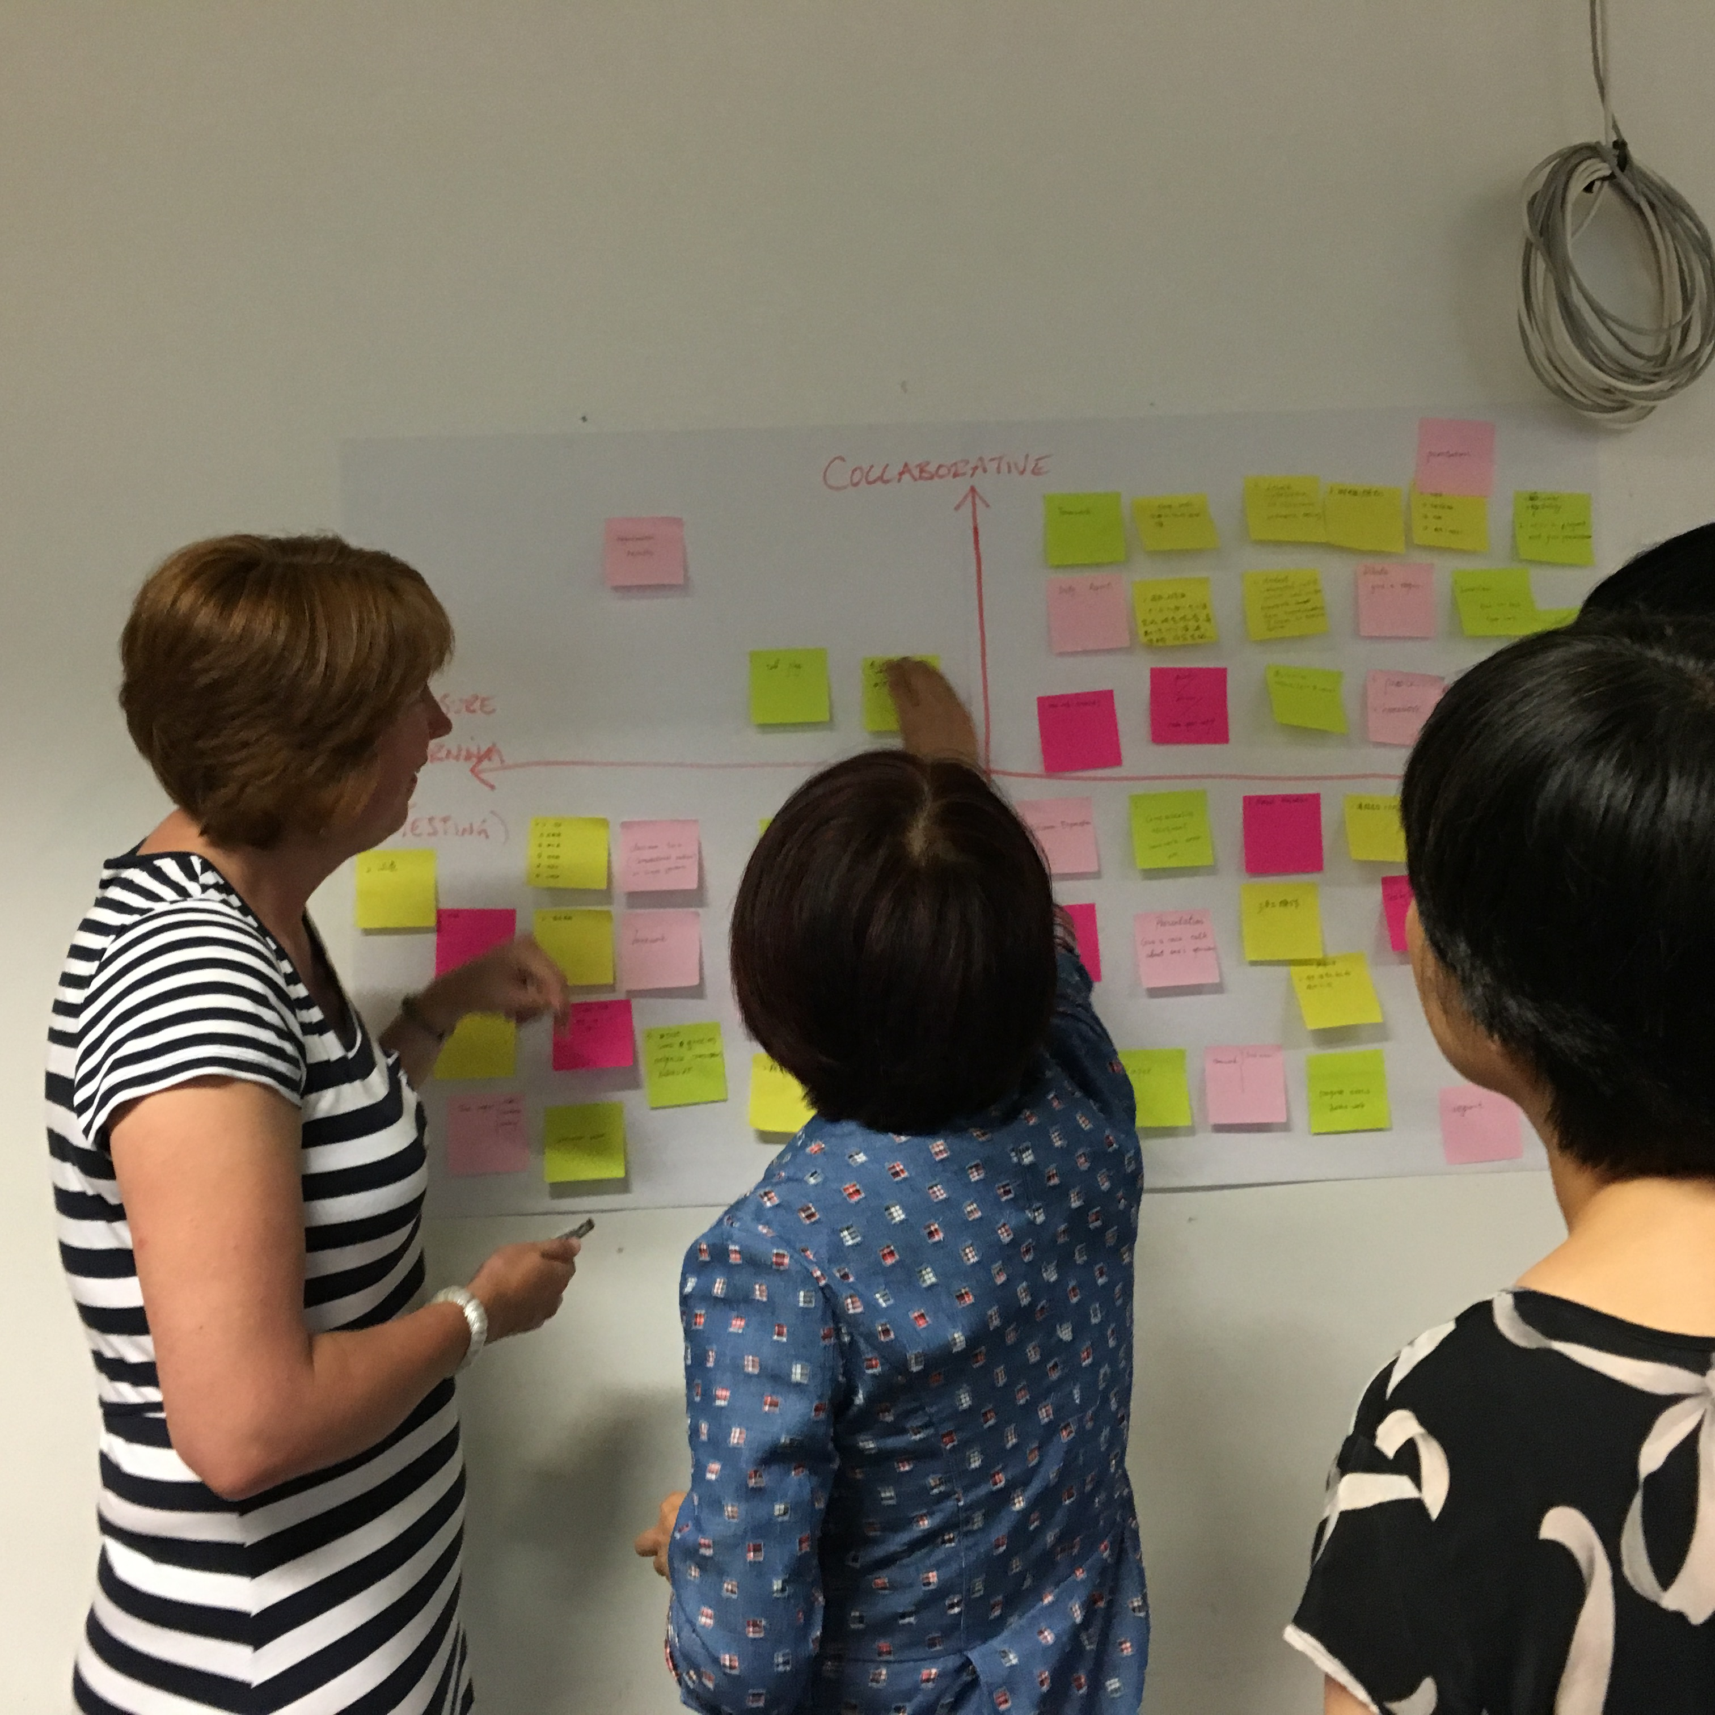
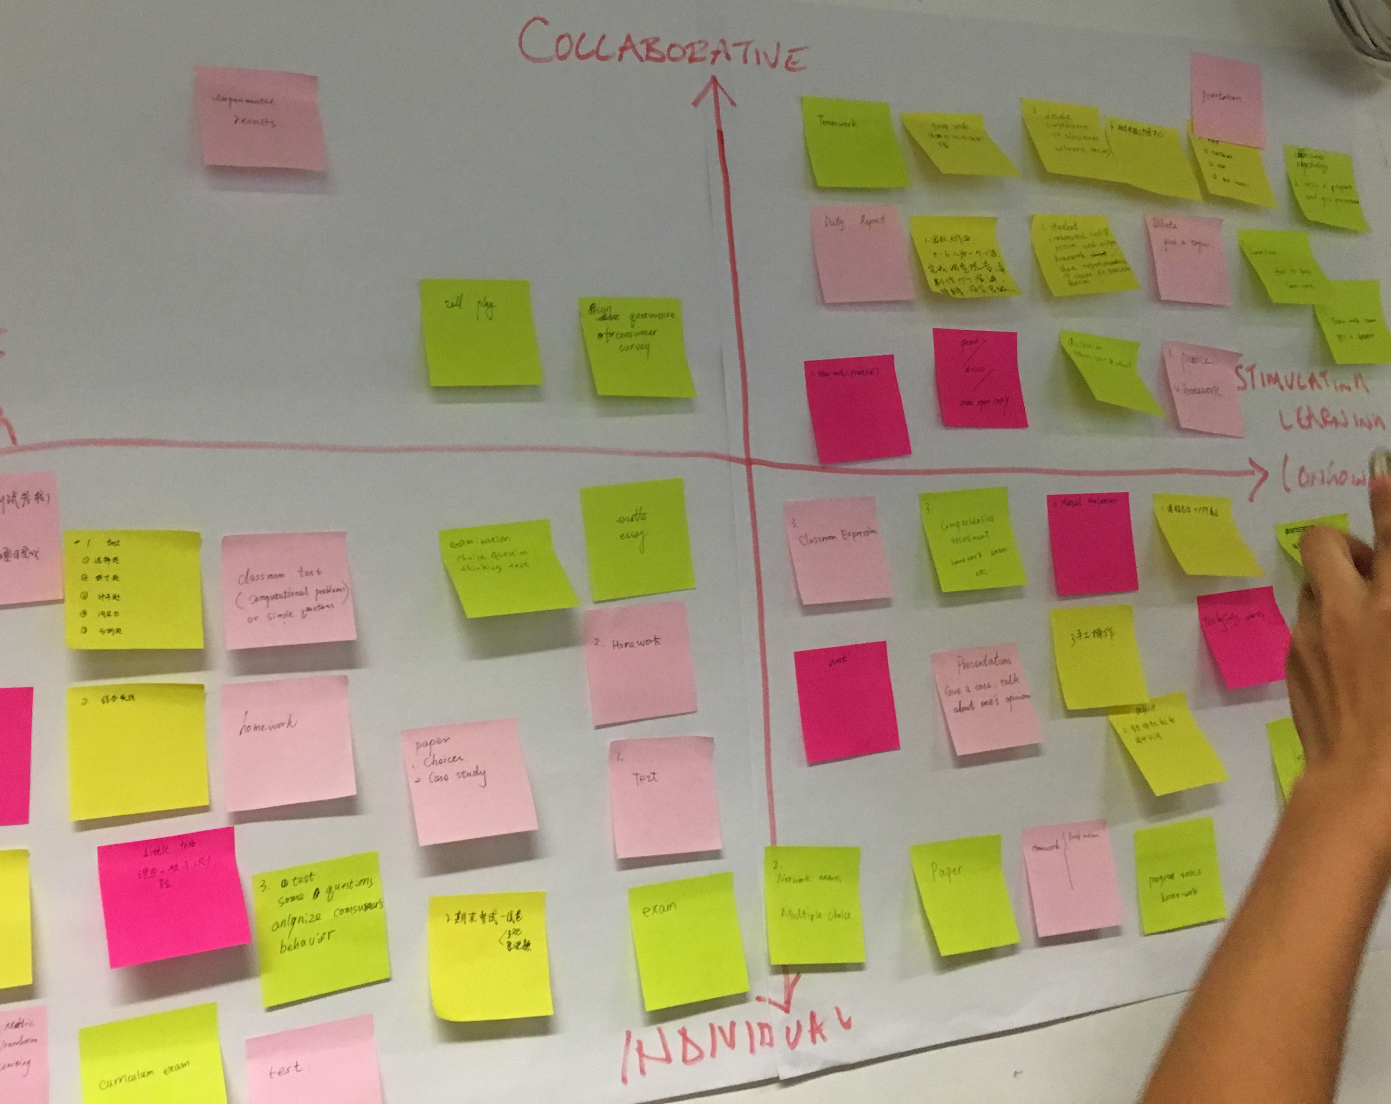
What types of assessment do you use?

Slide 38
课堂教学方法——课程考核（Assessment）
考核方式
论文-Essay（根据题目写文章，一年级开学后第二周，查重）
客观题测验-Objective testing（机器批阅）
小组学习-Group work（每组完成一份口头表达，墙报，论文等）
考试-Exam（综合性知识考察）
场景模拟-OSCE （实际操作）

Slide 39
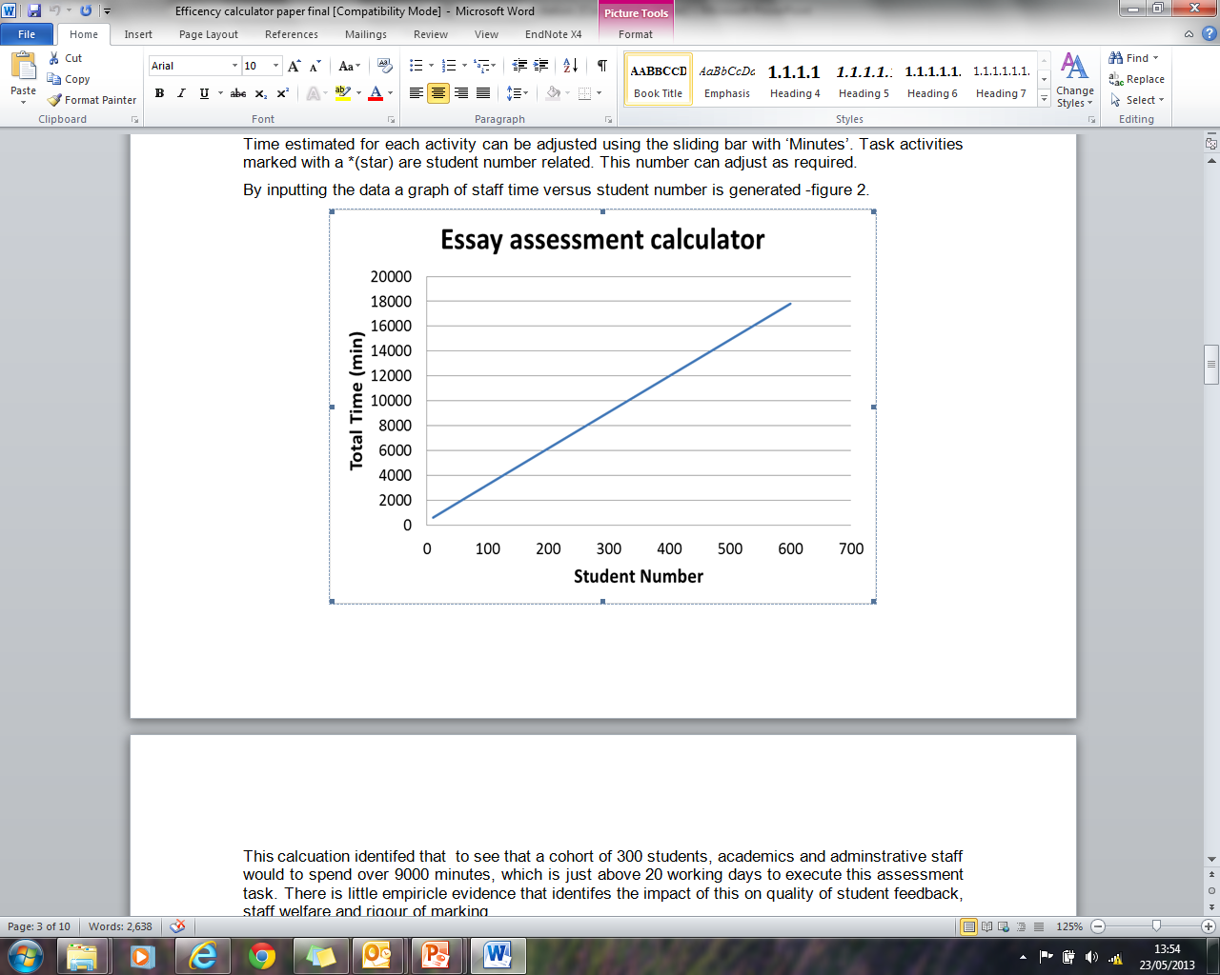
论文

Slide 40
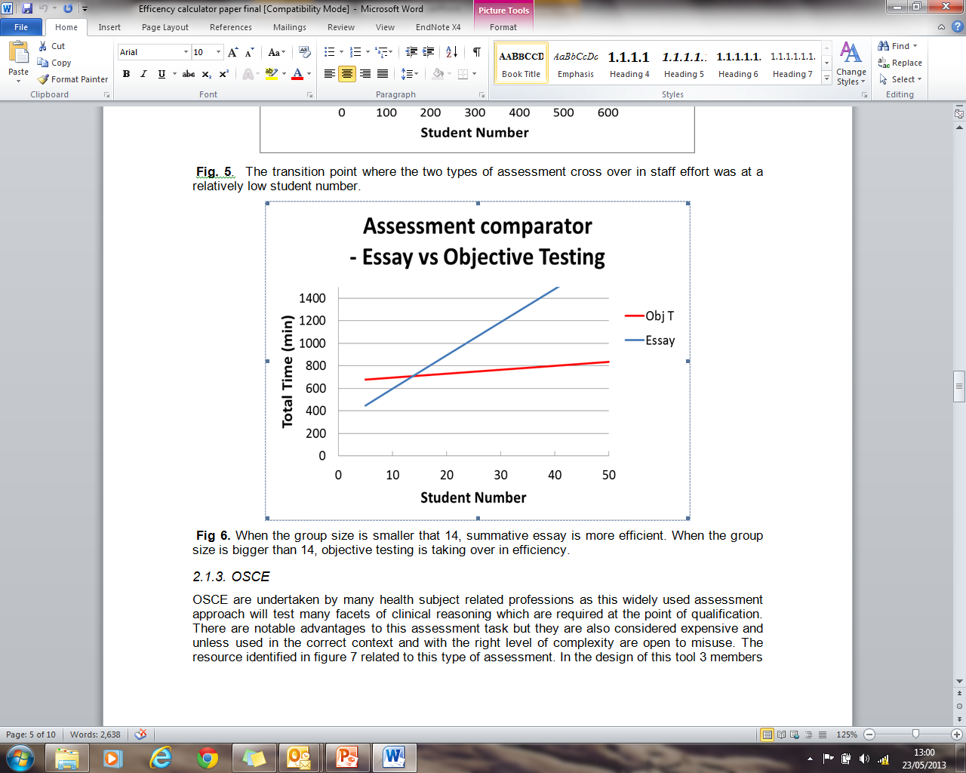
论文（Essay）vs客观题测验（Obj T）

Slide 41
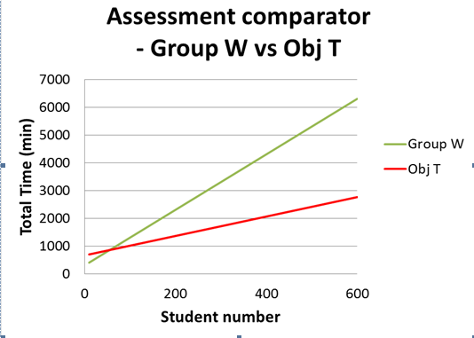
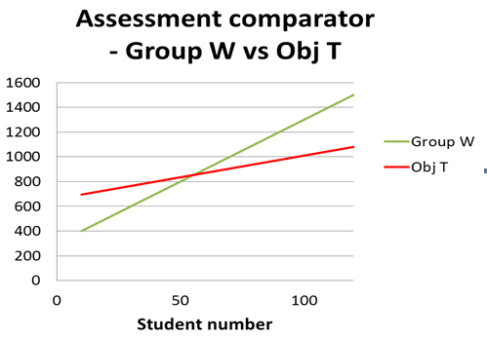
客观题测验vs小组学习

Slide 42
英国的教育体系与高校
课堂教学方法
提高学习的积极性（Activity）
课程考核（Assessment）
小组学习（Group work）

Slide 43
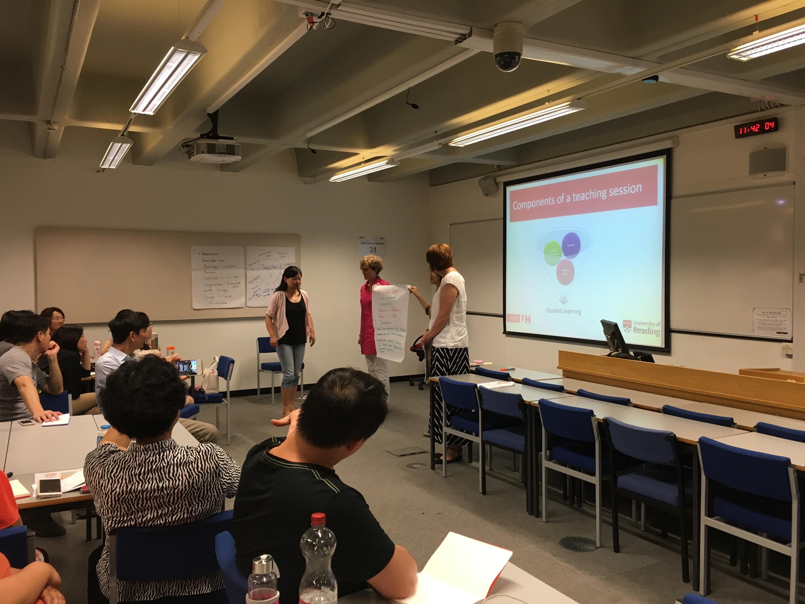
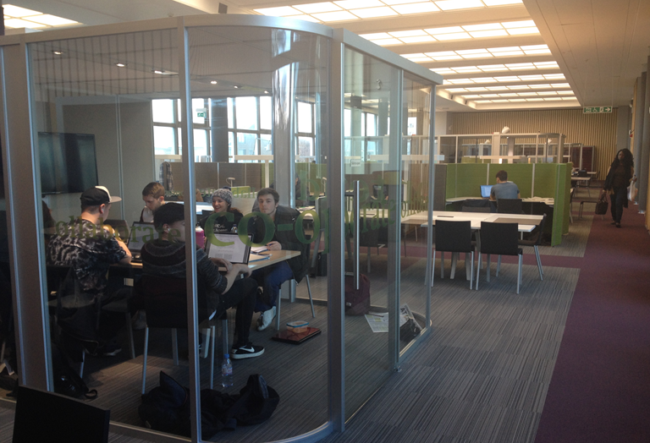
Group work

Slide 44

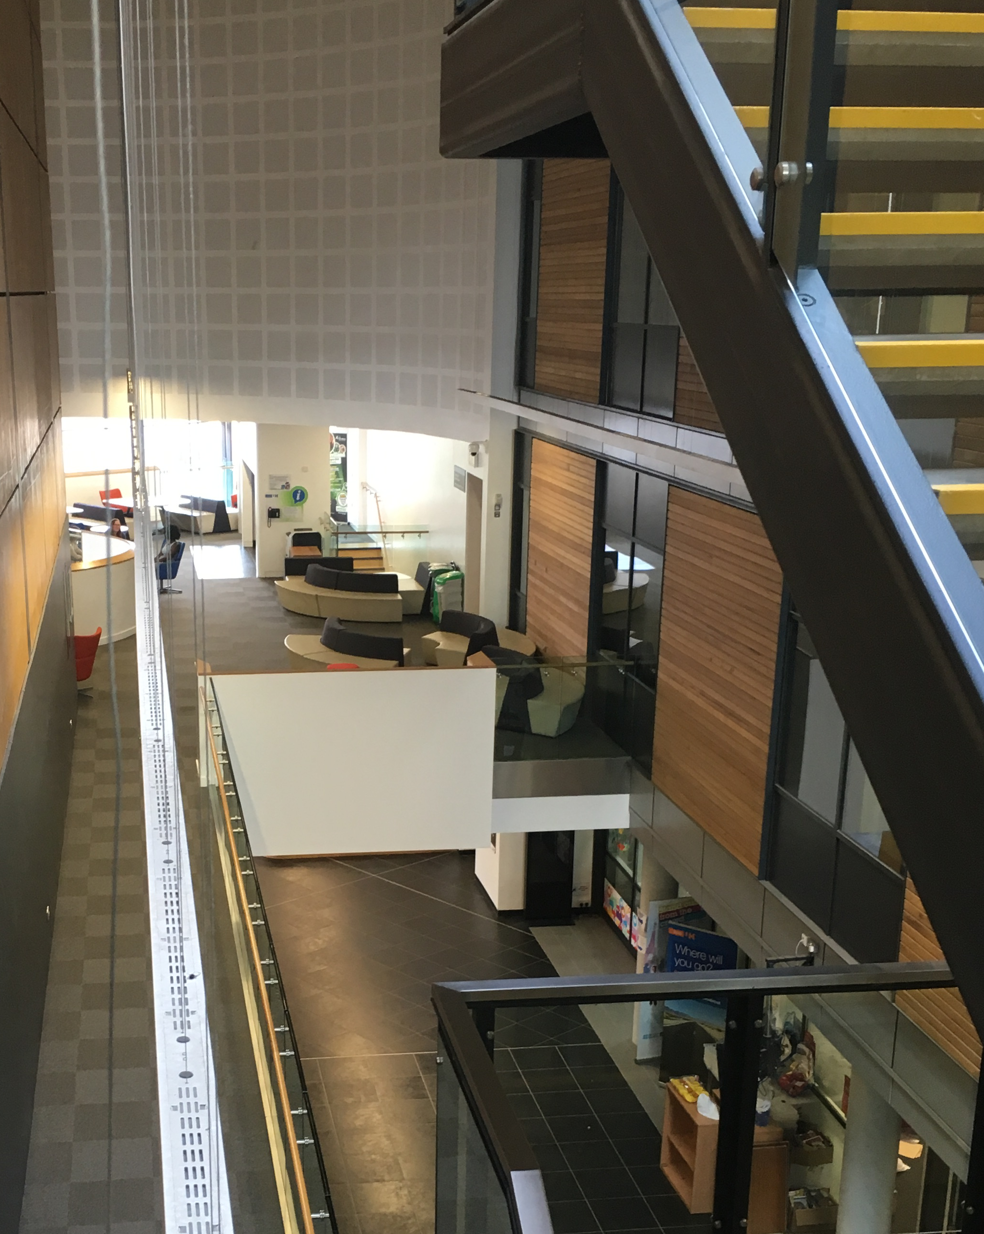
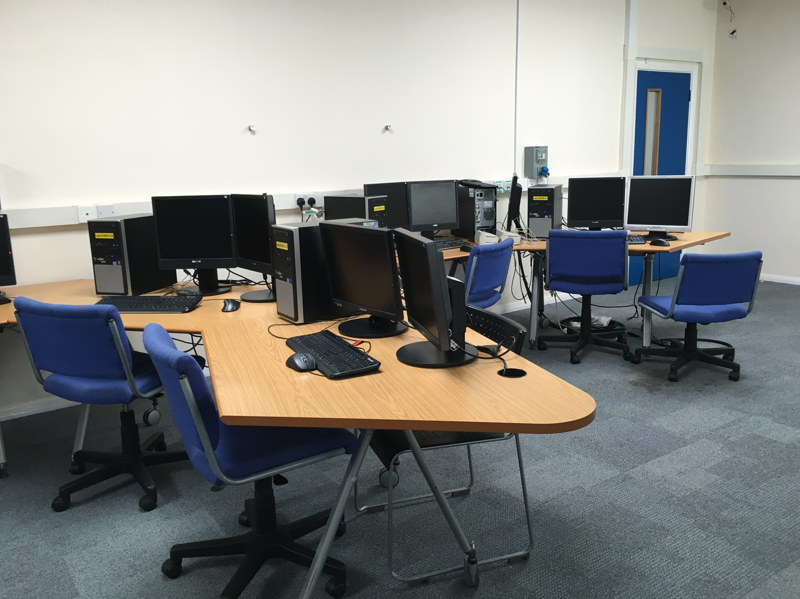
Group work

Slide 45

Have you done group work before?
Workshop – Student’s opinions
No
Yes

Slide 46
If you have done group work, was your experience:
Workshop – Student’s opinions
Very pleasant
Pleasant
Neutral
Not pleasant
Awful

Slide 47
What do you like the best for group work?
Workshop – Student’s opinions
Share the tasks
Learn from each other
Make friends
Have fun

Slide 48
What do you like the least for group work?
Workshop – Student’s opinions
Some people do not attend
Some people do not do the work
Some people are too dominant
Some people are aggressive

Slide 49

I prefer the poster group to be:
Workshop – Student’s opinions
formed by the students
assigned by the tutor

Slide 50
Tips
提前告知小组规则
团队合作分计入总成绩
分组人数4-5人最佳
评价要客观（自评、互评、教师评）

Slide 51
Mark distribution
Correct filling in of front sheet – 5%
Abstract – 5%
Introduction – 10%
Materials and Methods – 5%
Results – Information in figures, tables and calculations – 20%
Results – Text information – 10%
Discussion – 20%
Correct use of format – 5%
Correct referencing – 10%
Attending marking session – 5%
Online reflection and evaluation – 5% (afterwards)

Slide 52
Thank you！

