Slide 1
创新能力培养课程对学生的创造力思维提升
的有效性分析
THE EFFECTIVENESS OF A CREATIVITY COURSE
ON DEVELOPING CHINESE DESIGN STUDENTS’
CREATIVE THINKING
朱 花
2018.10.24

Slide 2
创造性思维的培养
什么是创造性思维能力？
这种能力可以培养吗？
Creative Thinking :是感知困难，对于解决方案提出猜测和假设，评估和测试这些假设，最终得到解决方案的过程。（Torrance 1966，p8）

Slide 3
研究目的 Research Purpose
调查研究创新能力培养课程教学的有效性
The purpose of this study is to investigate the overall effectiveness of a creativity course in developing creative thinking in Chinese university design students.

Slide 4
研究问题 Research Question
1. 一个学期的创造性思维培养课程对于学生总体创造力思维的影响
1. Can a one-semester creativity training course produce gains in overall creativity scores measured by standard tests of creativity in Chinese design students, compared to the scores obtained by students who do not take the course?

Slide 5
研究问题 Research Question
2. 一个学期的课程对于学生五大创作力思维维度的影响
2. Can a one-semester creativity training course improve fluency, originality, elaboration, abstractness of titles, and resistance to premature closure scores on the standard tests of creativity in a group of design students, compared to the scores obtained by students who do not take the course?

Slide 6
研究方法 Methodology

Slide 7
Methodology
采用了准实验，前测与后测的设计方案
This study uses quasi-experimental, pretest-posttest design.

Slide 8
Methodology — Population and Sample
研究对象总体 Population
Design students from a private college in Shanghai, China.
便利抽样 Convenience Sample
31 design students in the treatment group
2 classes were randomly selected from the 20 freshmen classes.
31 students in control group

Slide 9
Methodology — Population and Sample
Background Characteristics of the Study Samples
Group | Female | Male | Average Age
Control Group 控制组 (n=31) | 20 | 24 | 18.77
Treatment Group 实验组 (n=31) | 11 | 7 | 18.71

Slide 10
Methodology —量表 Instrumentation
托兰斯创造性思维测验
Figural Torrance Tests of Creative Thinking (TTCT)
由美国明尼苏达大学心理学教授托兰斯编制（1966），是目前应用最广泛的创造力测验。
从1966年2008年，有30万的美国人参加了这一测试。
托兰斯测试经历了数次修订，被业界认为是对发散性思维的可靠检测。

Slide 11
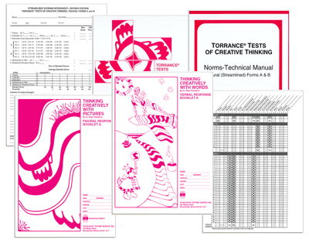
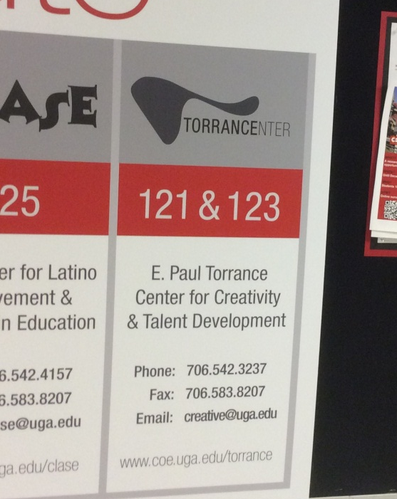
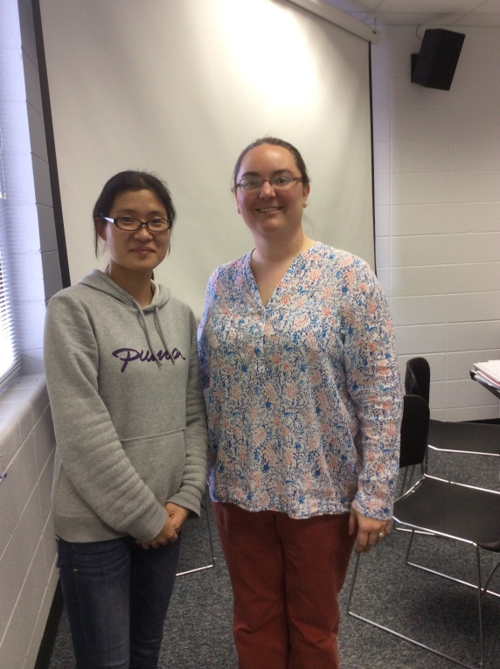
Methodology —量表 Instrumentation
托兰斯创造性思维测验
Figural Torrance Tests of Creative Thinking (TTCT)

Slide 12
Methodology —量表 Instrumentation
Design students are supposed to think and express ideas visually.
The test is useful for people from different language backgrounds and different cultures.
TTCT possess convincing reliability and validity.
Figural Torrance Tests of Creative Thinking (TTCT)

Slide 13
Methodology- 实验步骤 Procedures
Group | Pre-test | Treatment | Post-test
Control Group | TTCT-Figural Form A | Not taking creativity course | TTCT-Figural Form B
Treatment Group | TTCT-Figural Form A | Taking creativity course | TTCT-Figural Form B
Fall semester (September 2014)
December 2014

Slide 14
课程介绍 The Creativity Course Design
AUTA模型
美国创造学家戴维斯先生(G. A. Davis)于1980年在认知情感理论的基础上提出了由意识、理解、技法和实现四个环节构成的创造力开发模式，实现创造力由创造潜能到创造能力的转化，简称戴维斯AUTA模式理论。
Davis, G. A. A model for teaching for creative development [J]. Poeper Review, 1982, 5(2):27-29.

Slide 15
The Creativity Course Design
AUTA Model
Creativity Course Plan
Awareness:
Increase one’s creativity consciousness
Component 1:
Lectures, discussions about the importance of creativity, central theories on creativity
Understanding:
Understand the topic of creativity
Component 2:
Lean how to use creative thinking techniques
Techniques:
Use personal and standard creative thinking techniques to find creative ideas
Component 3:
Deal with real problems ad design problems using creative thinking techniques.
Self-Actualization:
Actualize one’s creative potential

Slide 16
The Creativity Course Design
AUTA 理论 | 教学内容 | 教学方法
意识（Awareness）： 增强学习者的创新意识。 | 模块一（理论基础） 创造性思维对于社会、艺术设计领域以及个人发展的重要性。 创造和创造性思维相互理论：创造过程，创新人格特质，创新思维的定义和评测。 | 案例讲解、启发式讨论
理解（Understanding） 培养学习者对于创新知识和理论的理解能力。
技法（Techniques） 培养学生创造性思维技巧。 | 模块二（思维技法训练） 创造性思维技法的分类、原理、操作过程以及在艺术设计中的应用，主要包括头脑风暴法，联想法、类比法、列举法和检核表法。 | 案例教学法
自我实现(Self-Actualization) 提升学习者的创造性潜能和创新能力。 | 模块三 （设计实践） 运用创造性思维技法来完成实际的设计方案。 | 任务驱动教学法

Slide 17
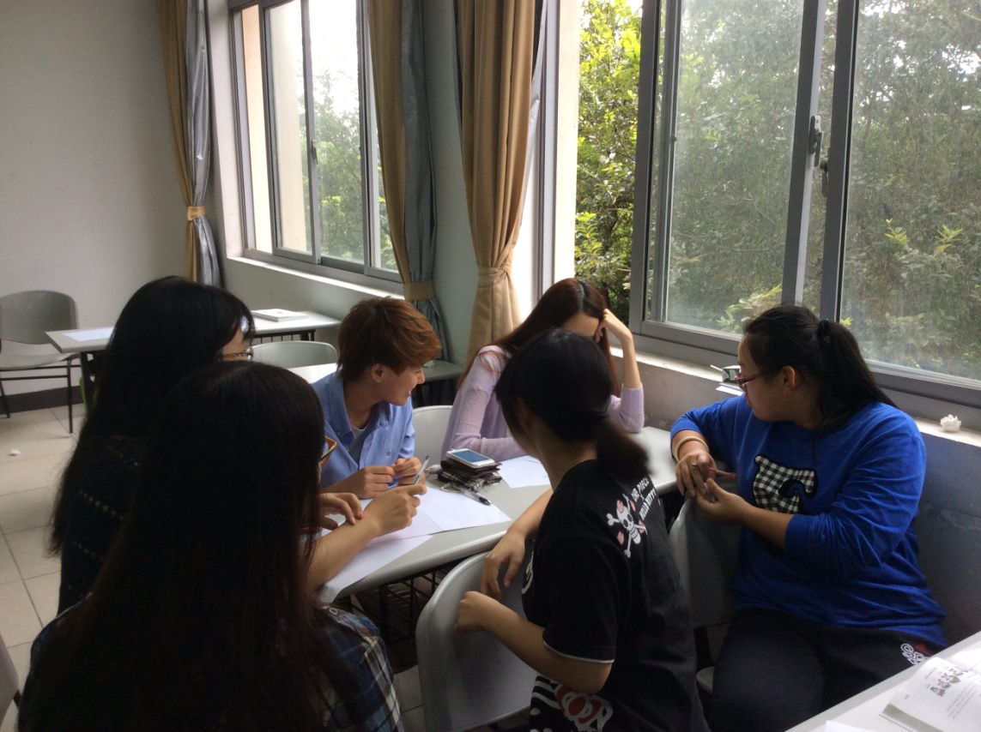
The Creativity Course Design
Course Activities
Students show their creative design project
Brainstorming activity

Slide 18
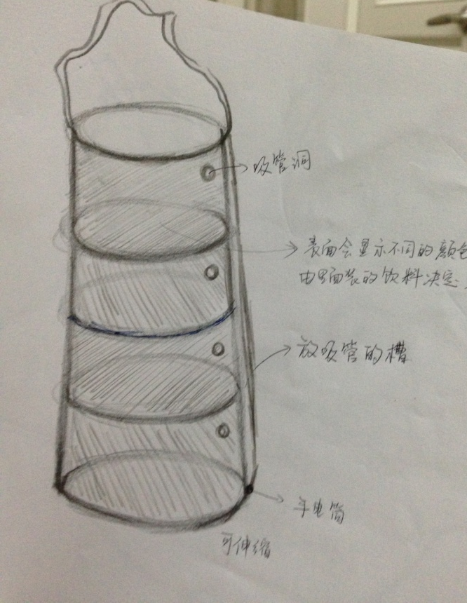
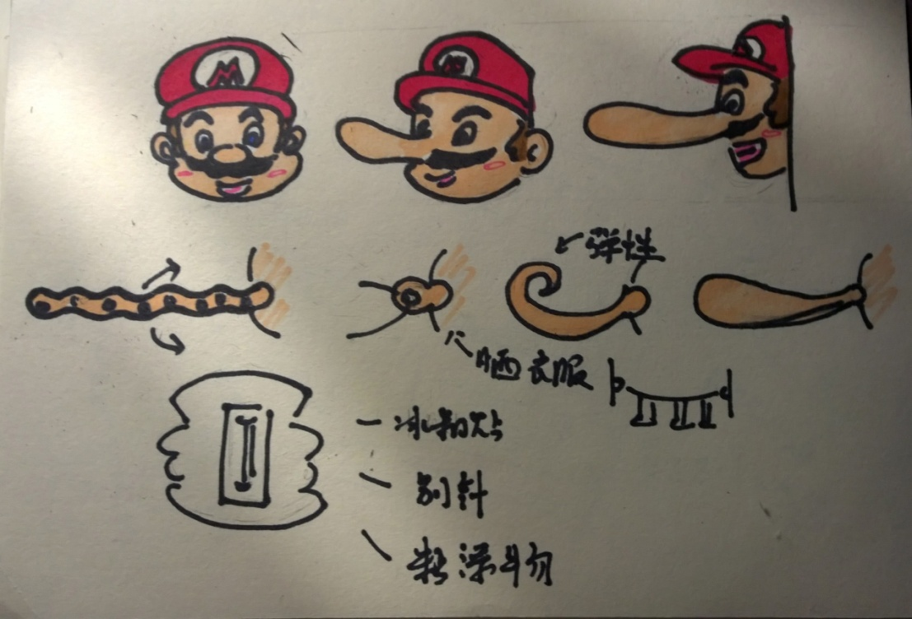
The Creativity Course Design
Course assignment – design for life
Retractable cup
Creative hooks

Slide 19
结论 Results

Slide 20
Results — Research Question 1
Research Question 1 :
一个学期的创新思维培养课程对于学生创造性思维能力提升的总体影响？
Analysis of Covariance (协方差分析ANCOVA) is used.
Dependent variable | Creativity Index of TTCT in the post test
Independent variable | Whether or not the student participates in the creativity course
Covariate variable | Creativity Index of TTCT in the pre test

Slide 21
Results — Research Question 1
Research Question 1 :
F (1, 59) =24.640, p <.001
Source | df | Mean Square | F | Sig | Partial Eta Squared | Observed Power^{b}
Pretesting | 1 | 2021.438 | 16.897 | .000 | .198 | .964
Group | 1 | 2947.724 | 24.640 | .000 | .208 | .972
Error | 59 | 119.40

Slide 22
Results — Research Question 1
Research Question 1 :
一个学期的创新思维培养课程对于学生创造性思维能力提升的总体影响？
The results :
F (1, 59) =24.640, p <.001
Revealed that the significant differences（存在显著差异） in Creativity Index in posttest between students in treatment group and control group

Slide 23
Results — Research Question 2
Research Question 2 :
一个学期的创新思维培养课程对于学生创造性思维能力各维度的影响？
Analysis of the results from five subscores of the TTCT.
For each subscore, an ANCOVA（协方差） is conducted.

Slide 24
Results — Research Question 2
Research Question 2 :
Subsocre1: Fluency（流利度）
The calculated F-value (1, 59) =15.534, p <.001 revealed that the significant differences in fluency scores in posttest between two groups
Source | df | Mean Square | F | Sig | Partial Eta Squared | Observed Power^{b}
Pretesting | 1 | 2447.735 | 14.563 | .000 | .054 | .439
Group | 1 | 2610.896 | 15.534 | .000 | .299 | .998
Error | 59 | 168.078

Slide 25
Results — Research Question 2
Research Question 2 :
Subsocre2: Originality （原创度）
F (1, 59) =25.107, p<.001.revealed that the significant differences in originality scores in posttest between two groups
Source | df | Mean Square | F | Sig | Partial Eta Squared | Observed Power^{b}
Pretesting | 1 | 1153.032 | 3.376 | .071 | .054 | .439
Group | 1 | 8576.064 | 25.107 | .000 | .299 | .998
Error | 59 | 341.579

Slide 26
Results — Research Question 2
Research Question 2 :
Subsocre 3: Elaboration （精致度）
F (1, 59 ) = 22.446, p<.001. revealed that the significant differences in elaboration scores in posttest between two groups.
Source | df | Mean Square | F | Sig | Partial Eta Squared | Observed Power^{b}
Pretesting | 1 | 9374.923 | 17.029 | .000 | .314 | .999
Group | 1 | 7785.404 | 22.446 | .000 | .276 | .997
Error | 59 | 346.845

Slide 27
Results — Research Question 2
Research Question 2 :
Subsocre4: Abstractness of Titles （抽象化，敏觉力）
F (1, 59) =.008, p=.930. revealed that the non-significant differences in abstractness of titles scores in posttest between two groups.
Source | df | Mean Square | F | Sig | Partial Eta Squared | Observed Power^{b}
Pretesting | 1 | 214.180 | .820 | .369 | .014 | .145
Group | 1 | 2.007 | .008 | .930 | .000 | .051
Error | 59 | 261.187

Slide 28
Results — Research Question 2
Research Question 2 :
Subsocre5: Resistance to Premature Closure （变通力）
F (1, 59) =.398, p= .530. revealed that the non-significant differences in resistance to premature closure scores in posttest between two groups.
Source | df | Mean Square | F | Sig | Partial Eta Squared | Observed Power^{b}
Pretesting | 1 | 657.848 | 6.224 | .015 | .057 | .456
Group | 1 | 42.108 | .398 | .530 | .047 | .389
Error | 59 | 105.691

Slide 29
Discussion
Conclusion :
一个学期的创新能力培养课程的确对于学生能力的提升有一定作用！
The one-semester creativity training course in this study did work to increase design students’ creative thinking levels.

Slide 30
Discussion
Recommendations（建议） :
1) 对于设计类专业教学中创新能力培养，单独开设课程更能提升学生的能力培养
2) 学生有更多的机会学习创造力技巧和创新思维技能来解决真实问题。
3) 应当重视教师在创新思维技能方面的岗前和岗内培养

Slide 31
Thank You !

