Slide 1

"韩素音青年翻译奖”竞赛培训
第一讲
胡雅楠

Slide 2
Topic analysis
题目分析
01
Training Schedule
培训安排
02
Passage analysis
文章分析
03
Translation exercise（Para 1）
翻译第一段

Slide 3
01
Topic Analysis

Slide 4
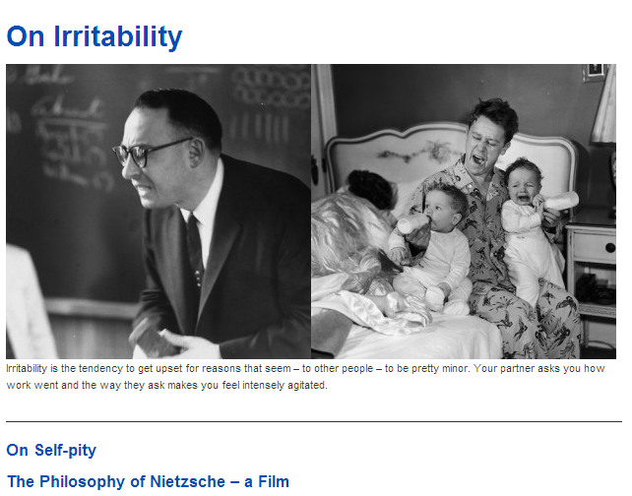

文章来源：http://thephilosophersmail.com/virtues/on-irritability/

Slide 5
On
关于，论及
e.g. write a paper on
Oscar Wilde
Irritability
1.易怒，烦躁
e.g The gloomy of irritability of one’s nature 生性忧郁烦躁
Irritability on temper 脾气烦躁
2.刺激物；烦恼事
3.【医】兴奋增盛，过敏
4.【生】应激性，兴奋性，刺激感受性

Slide 6
文中和Irritability相关词有：agitated (para.1)
explode (para. 1)
get het up (para.2)
brittle (para.3)
squabble (Para.9)
dispute (para.10)

Slide 7
02
Passage Analysis

Slide 8
Problem-Cause-Solution Order
Definition:Irritability is the tendency to get upset...(Para.1)
Question:Why,really, are they getting so agitated? (Para.2)
Cause: Para.3
Solution: Para. 9
Redefinition: A confused, inarticulate, often shameful attempt to
get us to understand how much someone is suffering and how
urgently they need our help. (Para.14 )

Slide 9
03
Translation Exercise

Slide 10
Irritability is the tendency/ to get upset for reasons/ that seem – to other people – to be pretty minor.
Tendency
1.趋势、趋向:
E.g. the tendency of today's young people to marry and bear children at late ages 当前年轻人晚婚和晚育的趋势
2.（性格或性质上的）倾向： have a tendency to talk too much 喜欢唠叨

Slide 11
Irritability is the tendency/ to get upset for reasons/ that seem – to other people – to be pretty minor.
易怒指的是容易因为一些在别人看来微不足道的理由而发火。
易怒指的是容易因为一些别人眼中看起来是鸡毛蒜皮的小事而发火。

Slide 12
Your partner asks you how work went and the way they ask makes you feel intensely agitated.
intense:
1. 强烈的、剧烈的
e.g. an intense light 一道强光
2. 紧张的
e.g. Diplomatic activity has been intense for many weeks. 好几周以来，外交活动紧张频繁。
agitated:
激动的、狂躁不安、焦虑的
e.g. in an agitated state
在狂躁不安的状态中
an agitated look
焦虑的神情

Slide 13

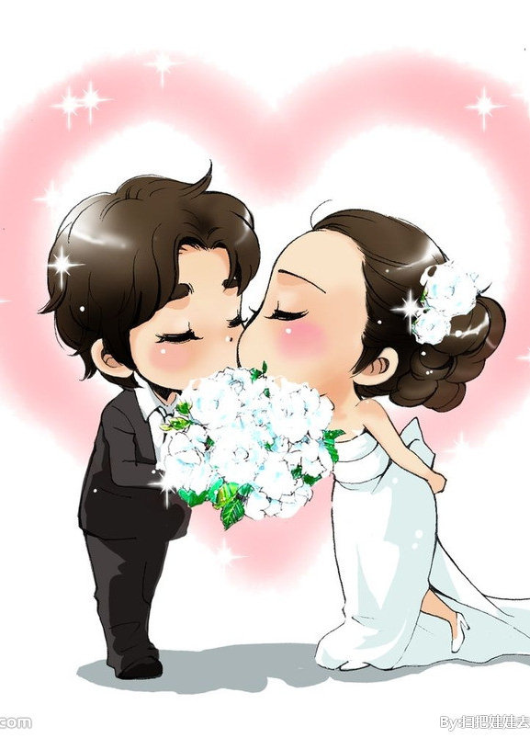
Partner？朋友？搭档？配偶？
Any clues from Para 3, 5, 13?

Slide 14
Para 3：to address troublesome aspects of joint life.
Para 5: what remains of their years on the planet in the company of someone who it appears cannot......
Para 13: married for three-and-a-half years

Slide 15
Your partner asks you how work went and the way they ask makes you feel intensely agitated.
（比如说/例如），你的先生或太太只是想问问你工作进展的如何了，但是他们问你的方式却让你越发不安。

Slide 16
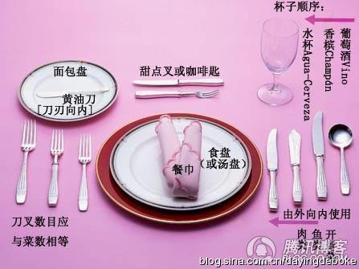
Your partner is putting knives and forks on the table before dinner and you mention (not for the first time) that the fork should go on the left hand side, not the right.

Slide 17
Your partner is putting knives and forks on the table before dinner and you mention (not for the first time) that the fork should go on the left hand side, not the right.
mention
提到，说起
e.g. He mentioned to me that he would leave soon.

Slide 18
Your partner is putting knives and forks on the table before dinner and you mention (not for the first time) that the fork should go on the left hand side, not the right.
(再比如)，你的先生或太太正在用餐前往桌上摆放刀叉，你提醒到（之前也说过）/(而且不只一次了) 叉子应该放在左手边，而不是右手边。

Slide 19
They then immediately let out a huge sigh and sweep the cutlery onto the floor and tell you that you can xxxx-ing do it yourself if you know better.
let out a sigh 叹口气
sweep: 扫，清扫，清除
e.g. Sweep the floor 扫地板
The room has been swept clean. 房间已经打扫干净
cutlery: 刀具

Slide 20
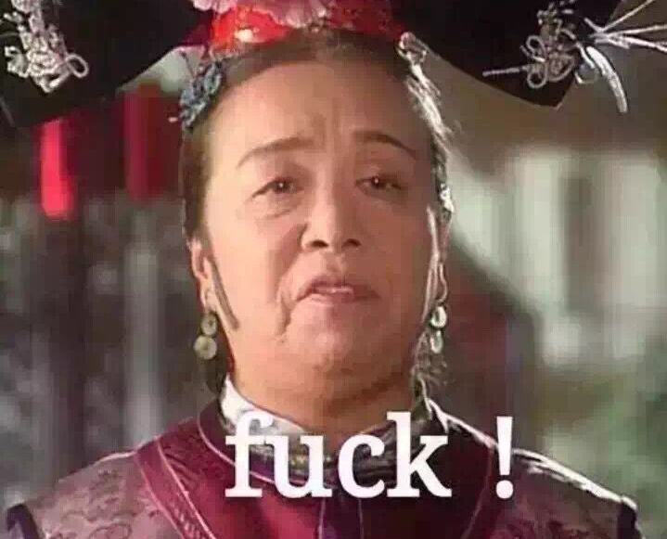
xxxx-(Four letter word)
Any of several short English words (often having 4 letters) generally regarded as obscene or offensive

Slide 21
They then immediately let out a huge sigh and sweep the cutlery onto the floor and tell you that you can xxxx-ing do it yourself if you know better.
于是他们立刻长长地叹了口气，然后一股脑儿把刀具全扔在地上，朝你吼道：有本事，自己滚去做。

Slide 22
It was the most minor of criticisms and technically quite correct. And now they’ve exploded.
technically: 从技术上来讲，从严格意义上来讲
e.g. a technically brilliant basketball match
一场技术精湛的篮球赛

Slide 23
It was the most minor of criticisms and technically quite correct. And now they’ve exploded.
整件事情的起因就是这句微不足道的提醒/纠正，而且也在理/严格意义上来说也没错。但是，他们却恼羞成怒/大为光火。

Slide 24
感谢聆听
Thanks

